Slide 1
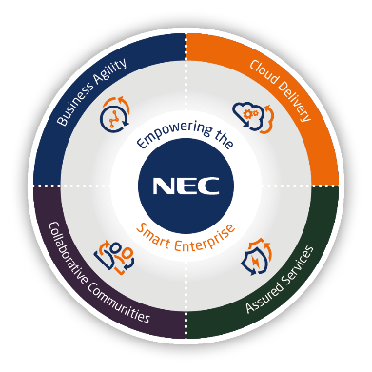


SL2100 Product Overview
Notes:
Rev 1.7 – 26 September 2018. Update Baseline image, remove Paritel terminals slide, Add slide for videos, remove UT880.
Rev 1.8 – 20 May 2019. Add R1.8 & R2 features

Slide 2

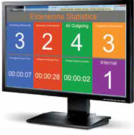
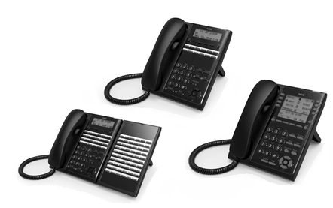
UNIVERGE SL2100 – Overview
The UNIVERGE SL2100 offers
Flexible chassis architecture
Simple, scalable, IP Unified Communications enabled solution
High reliability
Simplified user licensing structure
Built-in Unified Communications
Built-in Applications
Range of mobility devices
Vertical market-specific solution integrations
Wide-range of end-points
Single point configuration and management
Multi-carrier support
The following slides will give an overview of the SL2100 Portfolio offering solutions for all your requirements.
Refer also to the SL2100 R2 Feature Overview for details of news features available with the latest release of Main Software.

Slide 3
UNIVERGE SL2100 - Overview
The UNIVERGE SL2100 offers
Scalable system from 4 to 112 ports
Supports all trunk types: Analogue / ISDN BRI / ISDN PRI / SIP
Supports all terminal types: Analogue / Digital / IP / IPDECT
Backward compatible with SL1000/SL1100 terminals
Easy installation using PCPro Initial Setup Wizard
Built-in IP Resources: 8 channels built-in and can be expanded up to 128 channels
Built-in 4 SIP trunks and 4 IP Extensions with the CPU-C1-A*, can be expanded to 64 SIP trunks & 112 IP extensions with licenses
Built-in Voicemail system with 4 channels & 2 hour storage with the CPU-C1-A* (can be expanded to 16 channels & 120 hour) with call recording, auto-attendant and optional voicemail to e-mail integration
Built-in web browser based Applications (licenses required):
  InUC Video Conference and document sharing with UC Client Application (Presence, Buddy list, IM & Desktop terminal control, Browser Phone)
  InGuard Toll Fraud Guard
  InReports Call Management and Reporting
  InHotel Hotel Front of House for room reservations, guest folio and billing
MyCalls Applications: Call Manager, Call Recorder, Desktop & Console
* CPU-C1 also available – Does not have 2 hour InMail or SIP trunk & IP Extn licenses built in

Slide 4
UNIVERGE SL2100 – Capacity
System Capacity
  Expandable to 240 total ports
  Easy to configure system capacity by adding Interface Cards, Licenses & Chassis
Tables below are system maximum capacities – may require up to 3 KSU
Items | SL2100
Maximum TDM Ports | 240
Maximum TDM Trunks (Total) | 126
Analog | 36
ISDN BRI | 48
ISDN PRI | 90
Maximum TDM Extensions (Total) | 112
Digital | 72
Analog | 96
Maximum IP Ports | 176
IP Trunks | 64
IP Extensions | 112
Items | SL2100
InMail Hours | 2/15/120
Remote Nodes (IP System Interconnection) | 1000
VoIP Channels | 128
DDI Tables | 1000
Speed Dials | 1000
Conference | 2x16 = 32
Notes:
Extension capacity is the same for 2wire/4wire systems.
Capacity table is for 3 x KSU

Slide 5
UNIVERGE SL2100 – Capacity
System Capacity - for a single KSU
Tables below are system maximum capacities with a single KSU
Items | SL2100
Maximum TDM Ports | 80
Maximum TDM Trunks (Total) | 42
Analog | 12
ISDN BRI | 16
ISDN PRI | 30
Maximum TDM Extensions (Total) | 32
Digital | 24
Analog | 32
Virtual | 50
Maximum IP Ports | 176
IP Trunks | 64
IP Extensions | 112
Items | SL2100
InMail Hours | 2/15/120
Remote Nodes (IP System Interconnection) | 1000
VoIP Channels | 128
DDI Tables | 1000
Speed Dials | 1000
Conference | 2x16 = 32
Notes:
Extension capacity of a single KSU is the same for 2wire/4wire systems.

Slide 6
UNIVERGE SL1000 to SL2100 Differences
Overview of differences between the SL1000 and the SL2100
Items | SL1000 | SL2100 (with Type A Terminals)
Hardware | The SL1000 system hardware and licenses cannot be used/migrated to an SL2100. There are certain peripheral items that are common to both systems: External battery box Wall mount kit for IP terminal Doorphone unit
Main KSU | Has 4 analogue trunk ports built in | Has no trunks built in
 | Has 8 hybrid extension ports built in | Has no hybrid ports built in
 | Has CPU card pre-installed | Does not have the CPU card pre-installed
 | Interface cards are installed by removing the lid and stacking onto the base board within the KSU | Interface cards are installed into slots on the front of the KSU, no need to remove the lid
 | Has capacity for 3 interface cards | Has capacity for 4 interface cards
 | Uses analogue trunk port 2 for External paging audio | The IP7WW-308-A1 card has a dedicated audio port for external paging
 | Uses analogue trunk port 3 for External MOH audio | The IP7WW-308-A1 card as a dedicated audio port for external MOH/BGM audio
 | Uses analogue trunk port 4 for External BGM audio
 | Uses hybrid ports 6 & 7 for doorphones | The IP7WW-308-A1 card uses hybrid ports 6 & 7 for doorphones
This table may not be complete in all respects

Slide 7
UNIVERGE SL1000 to SL2100 Differences
Overview of differences between the SL1000 and the SL2100
Items | SL1000 | SL2100 (with Type A Terminals)
Expansion KSU | Has a dedicated expansion KSU | Uses the same KSU for Main or Expansion
 | Has 4 analogue trunk ports built in | Has no trunks built in
 | Has 8 hybrid extension ports built in | Has no hybrid ports built in
 | Up to 3 expansion KSU can be installed | Up to 2 expansion KSU can be installed
 | Has the interface for connection to the Main KSU built in | Requires the IP7WW-EXIFE-C1 installing to provide the interface for connection to the Main KSU
Main and Expansion KSU dimensions | 375mm x 290mm x 115mm (wxhxd) | 330mm x 435mm x 93mm (wxhxd)
AC cable | On the left side of the KSU | At the rear of the KSU
Power switch | On the left side of the KSU | At the rear of the KSU
External battery box connector | On the front under the cable cover | At the rear of the KSU
Mounting | Wall | Wall or rack
Cable cover | Main & Expansion KSU have cable cover | No cable cover
This table may not be complete in all respects

Slide 8

UNIVERGE SL1000 to SL2100 Differences
Overview of differences between the SL1000 and the SL2100
Items | SL1000 | SL2100 (with Type A Terminals)
Wall Mounting main KSU | Wall space around KSU: Left side = 300mm Right side = 300mm Below = 200mm Above = 200mm Arrow shows direction of cabling to interface cards | Wall space around KSU: Left side = 300mm Right side = 300mm Below = 200mm Above = 200mm Arrow shows direction of cabling to interface cards
Rack Mounting | Not available | Available, 3U required (with ventilation above the KSU)
Interface card connections | RJ11 connectors, 1 port per connector (for analogue trunks & hybrid extensions) | RJ61 connectors: 3 ports per connector for analogue trunks 2 ports per connector for 4wire hybrid extensions 2 ports per connector for 2wire SLT extensions
Cable assemblies | RJ11 to bare end 3.5m RJ11 to 12 port RJ45 panel | RJ45 cables (2.0m) and adapters for analogue trunk and extension interfaces
KSU power requirement | 0.76A max @ 230VAC | 0.79A max @ 230VAC
SLT ring signal normal current | 20mA | 308-A1 & 008-A1 card: 25mA @ 300Ω, 21mA @ 600Ω 082 card: 22mA @ 300Ω, 20mA @ 600Ω
External sensor | 24V or 5V | 25V
This table may not be complete in all respects

Slide 9
UNIVERGE SL1000 to SL2100 Differences
Overview of differences between the SL1000 and the SL2100
Items | SL1000 | SL2100
Power fail transfer (CO line) | Available on the Main & expansion KSU, 1 port | Not available
CPU card | Does not have any IP resources built in to the CPU | Has 8 IP resources built in to the CPU
 | Requires MEMDB for certain system features/hardware | Does not require any memory expansion card
 | Uses Nucleus operating system | Uses Linux operating system
 | Requires PZ-VM21 card + CFVMS flash card for InMail | Has InMail built in (4 channels 2hour) on the CPU-C1-A CPU-C1 requires the SDVML/SDVMS card adding for InMail
 | Requires PZ-VM21 card to provide the CF card slot for system software upgrade by CF card | Has the SD card slot built in on the CPU
 | CPU card is pre-installed into the Main KSU | CPU card is not pre-installed into the KSU
CPU Lan port | IEEE802.3 10Base-T and 100Base-TX Compliant Speed: 10 Mbps/100 Mbps Auto Negotiation | IEEE802.3 100Base-TX Compliant (Full Duplex only) Speed: 100 Mbps Full duplex
This table may not be complete in all respects

Slide 10
UNIVERGE SL1000 to SL2100 Differences
Overview of differences between the SL1000 and the SL2100
Capacity for a single KSU
Items | SL1000 | SL2100
 | Capacity for a single KSU | Capacity for a single KSU
Maximum Trunks (Total) | 74 | 106
Analog | 16 | 12
ISDN BRI | 12 | 16
ISDN PRI | 30 | 30
IP | 32 | 64
Maximum Extensions (Total) | 96 | 128
Digital | 24 | 24
Analog | 32 | 32
IP | 64 | 112
This table may not be complete in all respects

Slide 11
UNIVERGE SL1000 to SL2100 Differences
Overview of differences between the SL1000 and the SL2100
Items | SL1000 | SL2100 (with Type A Terminals)
Analogue trunk + hybrid extension card | IP4WW-408E-A1 4 analogue trunks + 8 Hybrid extensions | IP7WW-308U-A1 3 analogue trunks + 8 Hybrid extensions 2 x Relays 2 x Audio ports (MOH/BGM/Page)
Analogue trunk card | None available | IP7WW-3COIDB-C1 3 analogue trunks Daughter board can be installed onto the 008U/000U cards
ISDN Primary Rate card | IP4WW-1PRIU-C1 Main card, taking one card position | IP7WW-1PRIDB-C1 Daughter board, can be installed onto the 008U/000U cards
Doorphone | Maximum 2 per KSU, 8 total per system Connect to hybrid ports 6 or 7 of the Main or expansion KSU Doorphone selection within system configuration | Maximum 6 per KSU, 6 total per system Connect to hybrid ports 6 or 7 of the IP7WW-308-A1 card Doorphone selection set by hardware links on the IP7WW-308-A1 card and system configuration
Relay contacts | Maximum 2 per KSU, 8 total per system Connection on the Main or expansion KSU | Maximum 6 per KSU, 11 total per system Connect to the IP7WW-308-A1 card
External Paging | Maximum 1 per KSU, 3 total per system Connection to an analogue trunk port | Maximum 3 per KSU, 3 total per system Connect to the IP7WW-308-A1 card
External MOH | Maximum 1 per system Connection to an analogue trunk port | Maximum 1 per system Connect to the IP7WW-308-A1 card
This table may not be complete in all respects

Slide 12
UNIVERGE SL1000 to SL2100 Differences
Overview of differences between the SL1000 and the SL2100
Items | SL1000 | SL2100 (with Type A Terminals)
External BGM | Maximum 1 per system Connection to an analogue trunk port | Maximum 1 per system Connect to the IP7WW-308-A1 card
Analogue modem | PZ-VM21 card required | EXIFB card required
Terminals (TDM) | SL1000 terminals (12/24Type A) | SL1000 terminals (12/24Type A) SL2100 terminals (12/24Type A)
Terminals (IP) | 24TiXH-C | 24TiXH-C 8IPLD-C DT820 6 button (IP extn license required) DT820 8 Button Self labelling (IP extn license required) GT210 (IP extn license required)
This table may not be complete in all respects

Slide 13
UNIVERGE SL1100 to SL2100 Differences
Overview of differences between the SL1100 and the SL2100
Items | SL1100 | SL2100 (with Type B Terminals)
Hardware | The SL1100 system hardware and licenses cannot be used/migrated to an SL2100. There are certain peripheral items that are common to both systems: External battery box Wall mount kit for IP terminal Doorphone unit Wireless Headset Adapter for 12Type B/24Type B terminals
Main KSU | Has 8 digital and 4 analogue extension ports built in | Has no extension ports built in
 | Has CPU card pre-installed | Does not have the CPU card pre-installed
 | Interface cards are installed by removing the lid and stacking onto the base board within the KSU | Interface cards are installed into slots on the front of the KSU, no need to remove the lid
 | Has capacity for 2 interface cards | Has capacity for 4 interface cards
 | Has external paging audio (3.5mm jack) built in to the KSU | The IP7WW-082U-B1card has an audio port for external paging (RJ61 connection)
 | Has external MOH audio (3.5mm jack) built in to the KSU | The IP7WW-082U-B1 card as a dedicated audio port for external MOH/BGM audio
 | Has external BGM audio (3.5mm jack) built in to the KSU
 | Doorphones connect to SLT ports built in to the KSU | Doorphones connect to SLT ports on the IP7WW-082U-B1 card
This table may not be complete in all respects

Slide 14
UNIVERGE SL1100 to SL2100 Differences
Overview of differences between the SL1100 and the SL2100
Items | SL1100 | SL2100
Expansion KSU | Has a dedicated expansion KSU | Uses the same KSU for Main or Expansion
 | Has 8 digital and 4 analogue extension ports built in | Has no extension ports built in
 | Up to 3 expansion KSU can be installed | Up to 2 expansion KSU can be installed
 | Has the interface for connection to the Main KSU built in | Requires the IP7WW-EXIFE-C1 installing to provide the interface for connection to the Main KSU
Main and Expansion KSU dimensions | 375mm x 290mm x 115mm (wxhxd) | 330mm x 435mm x 93mm (wxhxd)
AC cable | On the left side of the KSU | At the rear of the KSU
Power switch | On the left side of the KSU | At the rear of the KSU
External battery box connector | On the front under the cable cover | At the rear of the KSU
Mounting | Wall | Wall or rack
Cable cover | Main & Expansion KSU have cable cover | No cable cover
This table may not be complete in all respects

Slide 15
UNIVERGE SL1100 to SL2100 Differences
Overview of differences between the SL1100 and the SL2100
Items | SL1100 | SL2100 (with Type B Terminals)
Wall Mounting main KSU | Wall space around KSU: Left side = 300mm Right side = 300mm Below = 200mm Above = 200mm Arrow shows direction of cabling to interface cards | Wall space around KSU: Left side = 300mm Right side = 300mm Below = 200mm Above = 200mm Arrow shows direction of cabling to interface cards
Rack Mounting | Not available | Available, 3U required (with ventilation above the KSU)
Interface card connections | RJ61 connectors, 4 ports per connector (for analogue trunks, digital and analogue extensions) | RJ61 connectors: 3 ports per connector for analogue trunks 4 ports per connector for digital extensions 2 ports per connector for SLT extensions on the 082 card 2 ports per connector for SLT extensions on the 008 card
Cable assemblies | RJ61 to bare end 3.5m RJ61 to RJ45 panel (16/24 port) | RJ45 Panels (16/24/40 port) RJ45 cables (2.0m) and adapters
KSU power requirement | 0.76A max @ 230VAC | 0.79A max @ 230VAC
SLT ring signal normal current | 20mA | 308-A1 & 008-A1 card: 25mA @ 300Ω, 21mA @ 600Ω 082 card: 22mA @ 300Ω, 20mA @ 600Ω
External sensor | 24V or 5V | 25V
This table may not be complete in all respects

Slide 16
UNIVERGE SL1100 to SL2100 Differences
Overview of differences between the SL1100 and the SL2100
Items | SL1100 | SL2100
Power fail transfer (CO line) | Available on the 4COIDB, 1 port | Not available
CPU card | Does not have any IP resources built in to the CPU | Has 8 IP resources built in to the CPU
 | Requires MEMDB for certain system features/hardware | Does not require any memory expansion card
 | Uses Nucleus operating system | Uses Linux operating system
 | Requires PZ-VM21 card + CFVMS flash card for InMail | Has InMail built in (4 channels 2hour)
 | Requires PX-VM21 card to provide the CF card slot for system software upgrade by CF card | Has the SD card slot built in
 | CPU card is pre-installed into the Main KSU | CPU card is not pre-installed into the KSU
CPU Lan port | IEEE802.3 10Base-T and 100Base-TX Compliant Speed: 10 Mbps/100 Mbps Auto Negotiation | IEEE802.3 100Base-TX Compliant (Full Duplex only) Speed: 100 Mbps Full duplex
This table may not be complete in all respects

Slide 17
UNIVERGE SL1100 to SL2100 Differences
Overview of differences between the SL1100 and the SL2100
Items | SL1100 | SL2100
Capacity for a single KSU
Maximum Trunks (Total) | 70 | 106
Analog | 12 | 12
ISDN BRI | 12 | 16
ISDN PRI | 30 | 30
IP | 32 | 64
Maximum Extensions (Total) | 96 | 128
Digital | 24 | 24
Analog | 20 | 32
IP | 64 | 112
This table may not be complete in all respects

Slide 18
UNIVERGE SL1100 to SL2100 Differences
Overview of differences between the SL1100 and the SL2100
Items | SL1100 | SL2100 (with Type B Terminals)
Digital Extension card | IP4WW-080E-B1 8 Digital extensions | IP7WW-082U-A1 8 Digital extensions + 2 SLT extensions 2 x Relays 2 x Audio ports (MOH/BGM/Page)
Analogue Trunk card | IP4WW-4COIDB-B1 4 Analogue trunks Daughter board can be installed onto the 080/008/000 cards or the main/expansion KSU base board | IP7WW-3COIDB-C1 3 analogue trunks Daughter board can be installed onto the 082/008/000 cards
Analogue Extension card | IP4WW-008E-B1 8 Analogue extensions | IP7WW-008U-C1 8 Analogue extensions
ISDN Primary Rate card | IP4WW-1PRIU-C1 Main card, taking one card position | IP7WW-1PRIDB-C1 Daughter board, can be installed onto the 082/008/000 cards
Doorphone | Maximum 2 per KSU, 6 total per system Connect to SLT ports 3 or 4 of the Main or expansion KSU Doorphone selection within system configuration | Maximum 6 per KSU, 6 total per system Connect to SLT ports of the IP7WW-082-B1 card Doorphone selection set by hardware links on the IP7WW-082-B1 card and system configuration
This table may not be complete in all respects

Slide 19
UNIVERGE SL1100 to SL2100 Differences
Overview of differences between the SL1100 and the SL2100
Items | SL1100 | SL2100 (with Type B Terminals)
Relay contacts | Maximum 2 per KSU, 8 total per system Connection on the Main or expansion KSU | Maximum 6 per KSU, 11 total per system Connect to the IP7WW-082-B1 card
External Paging | Maximum 1 per KSU, 3 total per system Connection on the Main or expansion KSU | Maximum 3 per KSU, 3 total per system Connect to the IP7WW-082-B1 card
External MOH | Maximum 1 per system Connection on the Main or expansion KSU | Maximum 1 per system Connect to the IP7WW-082-B1 card
External BGM | Maximum 1 per system Connection on the Main or expansion KSU | Maximum 1 per system Connect to the IP7WW-082-B1 card
Analogue modem | PX-VM21 card required | EXIFB card required
Terminals (TDM) | SL1100 terminals (12/24Type B) | SL1100 terminals (12/24Type B) SL2100 terminals (12/24Type B) DT430 terminals (12D/24D)
Terminal features | Have backlit keypad | Do not have backlit keypad
Terminals (IP) | 24TiXH-C | 24TiXH-C 8IPLD-C DT820 6 button (IP extn license required) DT820 8 Button Self labelling (IP extn license required) GT210 (IP extn license required)
This table may not be complete in all respects

Slide 20
UNIVERGE SL1000/SL1100 to SL2100 Differences
Overview of differences between the SL1000/SL1100 and the SL2100
Items | SL1000 & SL1100 | SL2100
System Selection | Selection of either SL1000 or SL1100 is determined by the Main KSU SL1000 = IP4EU-1632M-A SL1100 = IP4EU-1228M-B | SL2100 is a combined system using a single KSU choice
Terminal Selection (Type A or Type B) | SL1000 uses Type A terminals (4wire) SL1100 uses Type B terminals (2wire) | The selection of the digital terminal type is determined by the installation of the IP7WW-082-B1 card in any slot of the Main KSU: Main KSU does not have IP7WW-082-B1 card installed = Only Type A (4wire) digital terminals can be connected Main KSU has IP7WW-082-B1 card installed = Only Type B (2wire) digital terminals can be connected It is not possible to connect both Type A and Type B digital terminals to the same SL2100 system IP terminals are not effected by the
ISDN BRI S-Point Power feed | The 2BRIU card supports power feed for S-Point mode | The 2BRIU card does not support power feed for S-Point mode
This table may not be complete in all respects

Slide 21
UNIVERGE SL1000/SL1100 to SL2100 Differences
Overview of differences between the SL1000/SL1100 and the SL2100
Items | SL1100 | SL2100
VRS | 2 ch 8 minutes storage, 4 messages, 1 language Answer machine feature Can be expanded to 16 channels with MEMBD | CPU-C1 / CPU-C1-A 4ch 100 messages 2hour storage built in, 1 language (Language can be changed) Answer machine feature Can be expanded to 16 channels with EXIFB card
InMail | Requires PZ-VM21 card + CFVMS flash card 2ch 15hour storage Can be expanded to 16 channels with MEMDB + licenses | CPU-C1 No InMail built in InMail requires SD card: 4ch InMail with 15 hour storage with the SDVMS 4ch InMail with 120 hour storage with the SDVML Can be expanded to 16 channels with EXIFB card CPU-C1-A 4ch 2hour storage built in Can be expanded to 15 hour storage with the SDVMS Can be expanded to 120 hour storage with the SDVML Can be expanded to 16 channels with EXIFB card
VoIP | Requires the VOIPDB card and MEMDB card to be installed 16 resources Can be expanded to 32 resources with license | 8 resources built in to the CPU Can be expanded to 128 resources with VOIPDB card and licenses
This table may not be complete in all respects

Slide 22
UNIVERGE SL1000/SL1100 to SL2100 Differences
Overview of differences between the SL1000/SL1100 and the SL2100
Items | SL1000 & SL1100 | SL2100
Licenses | SIP Trunks 4 SIP trunks are included when the VOIPDB card is installed. SIP trunks 5 and above require licenses. | SIP Trunks CPU-C1 No SIP trunk licenses are included. SIP trunks 1 and above require licenses. CPU-C1-A 4 SIP trunk licenses are included. SIP trunks 5 and above require licenses.
 | SIP Extensions SIP extensions require licenses. Note - The 24TiXH IP terminal does not require a license | SIP Extensions CPU-C1 No SIP extension licenses are included SIP extensions 1 and above require licenses. CPU-C1-A 4 SIP extension licenses are included SIP extensions 5 and above require licenses. Note - The 24TiXH or 8IPLD IP terminals do not require a license IP extension license required for DT820, IPDECT, GT210 and 3rd party SIP devices
This table may not be complete in all respects

Slide 23
UNIVERGE SL1000/SL1100 to SL2100 Differences
Overview of differences between the SL1000/SL1100 and the SL2100
Items | SL1000 & SL1100 | SL2100
Licenses | IP Encryption Encryption License for 24TiXH IP Terminal 1 license per system | IP Encryption Encryption License for 24TiXH or 8IPLD IP Terminal 1 license per system
 | NAT Traversal NAPT License for 24TiXH IP Terminal 1 license per system | NAT Traversal Built in – no license required
 | InMail voicemail channels 2 channels are included with the InMail Channels 3 and above require a license 2 channel license up to 8 channels maximum if MEMDB card not installed With MEMDB card then up to 16 channels can be licensed | InMail voicemail channels 4 channels are built in with the CPU-C1-A 4 channels are built in with the SDVMS/SDVML SD cards Can be increased to 16 channels by adding the EXIFB card
This table may not be complete in all respects

Slide 24
UNIVERGE SL1000/SL1100 to SL2100 Differences
Overview of differences between the SL1000/SL1100 and the SL2100
Items | SL1000 & SL1100 | SL2100
Licenses | InMail Advance In-Mail Advanced Features License 1 license per system | InMail voicemail to e-mail InMail voicemail to e-mail License 1 license per system
 | Mobile Extension 4 Mobile extensions are included with the system. 5 and above require licenses. | Same specification as SL1x00
 | 3rd Party CTI 3rd Party CTI license 1 license per system | Same specification as SL1x00
 | XMLPro XMLPro is an advanced interface to system setup by 3rd party developers. 1 license per system | Same specification as SL1x00
 | Hotel Hotel/Motel Feature License 1 license per system | Same specification as SL1x00
This table may not be complete in all respects

Slide 25
UNIVERGE SL1000/SL1100 to SL2100 Differences
Overview of differences between the SL1000/SL1100 and the SL2100
Items | SL1000 & SL1100 | SL2100
Licenses | Hotel PMS Interface to a Property Management System for Hotel operation Hotel license also required 1 license per system – maximum of 32 rooms supported with PMS | Same specification as SL1x00
 | On-Board Applications Each on-board application is licensed 1 license per application (system license) | Same specification as SL1x00
 | VOIP Channel increase 16 VOIP channels are available when the VOIPDB card is installed VOIP channels 17~32 require a license 1 license per system | VOIP Channel increase (VOIPDB card only) 8 VOIP channels are available on the CPU, 16 VOIP channels are available when the VOIPDB card is installed VOIP channels 17~128 require a license 16 channels per license (maximum 7 licenses per system)
 | Web Video Web video conference channel 4 are built in 5~32 are licensed 1 license per channel | Same specification as SL1x00
This table may not be complete in all respects

Slide 26
UNIVERGE SL1000/SL1100 to SL2100 Differences
Overview of differences between the SL1000/SL1100 and the SL2100
Items | SL1000 & SL1100 | SL2100
Built in Applications | The SL2100 applications will have the same functionality as the SL1x00 Licenses can not be used or migrated to the SL2100
 | InGuard | InGuard
 | InReports | InReports
 | InHotel | InHotel
 | InUC | InUC
 |  | InUC Web Client
 |  | InUC Deskphone Control
 |  | InUC Browser Phone
PC Based Application | MyCalls Basic | Not available
 | MyCalls Call Manager | MyCalls Call Manager
 | MyCalls Call Recorder | MyCalls Call Recorder
 |  | MyCalls Console
 |  | MyCalls Desktop
 | UC Desktop Suite | UC Desktop Suite not available
This table may not be complete in all respects

Slide 27
UNIVERGE SL1000/SL1100 to SL2100 Differences
Overview of differences between the SL1000/SL1100 and the SL2100
Items | SL1000 & SL1100 | SL2100
Personal Speed Dial | Each extension has 20 personal speed dials | Each extension has 100 personal speed dials
DDI Tables | 800 | 1000
SIP Trunk Profiles | 2 | 6
Incoming Ring Groups | 25 | 50
Trunk Routes | 25 | 50
Trunk Groups | 25 | 50
Internal Paging Groups | 32 | 50
Call Pickup Groups | 32 | 50
Department Groups | 32 | 50
This table may not be complete in all respects

Slide 28
UNIVERGE SL1000/SL1100 to SL2100 Differences
Overview of differences between the SL1000/SL1100 and the SL2100
Items | SL1000 & SL1100 | SL2100
InACD | Not Available | Available in R1.5 Main Software 8 ACD Groups 20 Agents In Queue messaging via the VRS Position in Queue announcements Overflow to various destinations Two modes of login, Standard Login/AIC 8 ACD modes for a variety of routing options All Agent Activity is output in the P Commands and displayed/reported by MyCalls Call Centre
SLNet | Not available | Available in R1.5 Main Software Up to 50 nodes (SL2100 systems only) Centralised InMail voicemail Desk to Desk calling with Caller ID and name display Sharing trunk lines with remote systems Extension busy lamp information Shared Park Hold orbits
This table may not be complete in all respects

Slide 29
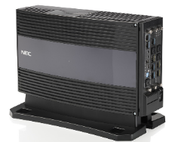
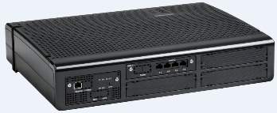
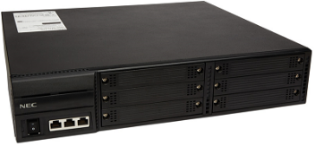
UNIVERGE SV9100 to SL2100 Differences
Overview of differences between the SV9100 and the SL2100
Items | SV9100 | SL2100
Chassis | Wall or stand mounted 9.5” 3 slots, no expansion Rack, floor or wall mounted 19” 6 slots, can be expanded | Chassis can be wall or rack mounted, 4 slots, can be expanded
This table may not be complete in all respects

Slide 30
UNIVERGE SV9100 to SL2100 Differences
Overview of differences between the SV9100 and the SL2100
Items | SV9100 | SL2100
Chassis dimensions | 9.5” chassis – 220mm x 115mm x 369mm (wxhxd) 19” chassis – 430mm x 88mm x 360mm (wxhxd) | 330mm x 435mm x 93mm (wxhxd)
AC cable | At the rear of the 9.5” or 19” chassis | At the rear of the chassis
Power switch | At the front of the 9.5” or 19” chassis | At the rear of the chassis
External Battery (Power fail) | Large battery box for 9.5” or 19” chassis (up to 6 batteries 12V 7Ah) Small battery box for 9.5” chassis (2 batteries 12V 0.8Ah) | External battery box available (2 batteries 12V 7Ah)
Internal Battery (Power fail) | Available for 19” chassis (2 batteries 12V 2.3Ah) | Not available
Slot covers | Screw mounted (spare covers available) | Knock-out (spare covers not available)
Chassis cable covers | Optional item for 9.5” or 19” chassis | Not available
Wall mounting | 9.5” integral, 19” requires CHS1U/2U kit | Integral
Rack mounting | 9.5” not available, 19” requires CHS2U rack brackets (2U) | Requires SL2100 rack mount shelf (3U)
Floor mounting | 9.5” not available, 19” requires CHS base unit & joint kit | Not available
This table may not be complete in all respects

Slide 31
UNIVERGE SV9100 to SL2100 Differences
Overview of differences between the SV9100 and the SL2100
Items | SV9100 | SL2100
Interface card connections | RJ61 connectors, 4 ports per connector (for analogue trunks, digital and analogue extensions) | RJ61 connectors: 3 ports per connector for analogue trunks 4 ports per connector for digital extensions of 082 card 2 ports per connector for digital extensions of 308/008 card 2 ports per connector for SLT extensions on the 082 card 2 ports per connector for SLT extensions on the 008 card
Cable assemblies | RJ61 to bare end 3.5m RJ61 to RJ45 panel (16/24/40 port) | RJ45 cables (2.0m) and adapters
19” Patch panels | 16/24/40 port available | 16/24/40 port available
Terminals | Digital – DT400 range IP – DT820 range, DT830 range, GT210 IPDECT – full range VoWLAN – 8440 Hotel – Cetis Analogue – Baseline, AT50/AT55 | Digital – Type A or Type B (DT430 are also available in selected regions) IP – DT820 range (no Gigabit/32 button support), 8IPLD, GT210 IPDECT – full range VoWLAN – 8440 Hotel – Cetis Analogue – Baseline, AT50/AT55
ISDN BRI S-Point Power feed | The 2BRIA card supports power feed for S-Point mode | The 2BRIDB card does not support power feed for S-Point mode
This table may not be complete in all respects

Slide 32
UNIVERGE SV9100 to SL2100 Differences
Overview of differences between the SV9100 and the SL2100
Items | SV9100 | SL2100
Chassis power requirements | 9.5” chassis: 1.19A max @ 230VAC 19” chassis: 1.19A max @ 230VAC per chassis | 0.79A max @ 230VAC per chassis
SLT ring signal normal current | 25mA | 308-A1 & 008-A1 card: 25mA @ 300Ω, 21mA @ 600Ω 082 card: 22mA @ 300Ω, 20mA @ 600Ω
Power fail transfer (CO line) | Available on the GCD-4COTA, 2 ports | Not available
CPU card | Does not have any IP resources built in to the CPU | Has 8 IP resources built in to the CPU
 | Uses Nucleus operating system | Uses Linux operating system
 | Uses SD-A1 or SD-B1 card for InMail | Has InMail built in (4 channels 2hour) with CPU-C1-A
 | SD card is mandatory (for Main Software) | SD card is optional
 | Installed into slot 1 of the chassis | Installed into dedicated CPU slot
Traffic capacity | 9200 BHCA | 2540 BHCA
Maintenance - hardware | Interface cards are replaceable with system powered on | System must be powered off to replace interface cards
Maintenance - Software | Main software upgrade locally or remotely via PCPro | Main software upgrade locally or remotely via PCPro. Automatically via external Maintenance Server
Software Assurance (SWA) | Available | Not available
This table may not be complete in all respects

Slide 33
UNIVERGE SV9100 to SL2100 Differences
Overview of differences between the SV9100 and the SL2100
Items | SV9100 9.5” Chassis | SV9100 19” chassis | SL2100
Capacity
Maximum Trunks (Total) | 400 | 400 | 128
Analogue | 16 | 184 | 36
ISDN BRI | 16 | 184 | 48
ISDN PRI | 60 | 360 | 90
IP | 400 | 400 | 64
Maximum Extensions (Total) | 896 | 896 | 128
Digital | 32 | 368 | 72
Analogue | 32 | 368 | 96
IP | 896 | 896 | 112
This table may not be complete in all respects

Slide 34
UNIVERGE SV9100 to SL2100 Differences
Overview of differences between the SV9100 and the SL2100
Items | SV9100 | SL2100
VRS | 2ch 100 messages 45 minutes storage built-in, 26 languages Can be expanded to 16 channels with licenses and 80 channels with IPLE card | CPU-C1 / CPU-C1-A 4ch 100 messages 2hour storage built in, 1 language (Language file can be changed) Answer machine feature Can be expanded to 16 channels with EXIFB card
InMail | InMail built in with the SD card 16ch InMail with 12 hour storage with the SD-A1 16ch InMail with 115 hour storage with the SD-B1 | CPU-C1 No InMail built in InMail requires SD card: 4ch InMail with 15 hour storage with the SDVMS 4ch InMail with 120 hour storage with the SDVML Can be expanded to 16 channels with EXIFB card CPU-C1-A 4ch 2hour storage built in Can be expanded to 15 hour storage with the SDVMS Can be expanded to 120 hour storage with the SDVML Can be expanded to 16 channels with EXIFB card
This table may not be complete in all respects

Slide 35
UNIVERGE SV9100 to SL2100 Differences
Overview of differences between the SV9100 and the SL2100
Items | SV9100 | SL2100
InMail mailboxes | Station Mailboxes = 896 Routing Mailboxes = 32 Group Mailboxes = 32 Total Mailboxes = 960 | Station Mailboxes = 128 Routing Mailboxes = 32 Group Mailboxes = 32 Total Mailboxes = 192
UM800 Voicemail | Available | Not available
VoIP Resources | No resources built in IPLE card required for VoIP resources 256 VoIP resources (assigned with each IP trunk/extension) | 8 resources built in o the CPU Can be expanded to 128 resources with VOIPDB card and licenses
This table may not be complete in all respects

Slide 36
UNIVERGE SV9100 to SL2100 Differences
Overview of differences between the SV9100 and the SL2100
Items | SV9100 | SL2100
Licenses | SIP Trunks 4 SIP trunks are included when the IPLE card is installed. SIP trunks 5 and above require licenses. | SIP Trunks CPU-C1 No SIP trunk licenses are included. SIP trunks 1 and above require licenses. CPU-C1-A 4 SIP trunk licenses are included. SIP trunks 5 and above require licenses.
Licenses | SIP Extensions 4 SIP extensions are included when the IPLE card is installed. SIP extensions 5 and above require licenses. Licenses for 3rd Party Standard SIP or NEC IP terminals | SIP Extensions CPU-C1 No SIP extension licenses are included SIP extensions 1 and above require licenses. CPU-C1-A 4 SIP extension licenses are included SIP extensions 5 and above require licenses. Note - The 8IPLD IP terminals do not require a license. IP extension license required for DT820, IPDECT, GT210 and 3rd party Standard SIP devices Single license for either Standard SIP or NEC IP terminals
This table may not be complete in all respects

Slide 37
UNIVERGE SV9100 to SL2100 Differences
Overview of differences between the SV9100 and the SL2100
Items | SV9100 | SL2100
MyCalls | MyCalls Call Manager (1st year included with SV9100) MyCalls Call Recorder MyCalls Console MyCalls Desktop Lite (included with SV9100) MyCalls Desktop MyCalls Enterprise MyCalls Calls Centre | MyCalls Call Manager MyCalls Call Recorder MyCalls Console MyCalls Desktop
Onboard Applications | InGuard InReports InHotel InUC | InGuard InReports InHotel InUC
Networking | Netlink SIP Trunk Networking KCCIS AspireNet | SIP Trunk Networking SLNet
BusinessConnect (BCT) | Available | Not available
Unified Calls for Business (UCB) | Available (selected regions) | Not available
This table may not be complete in all respects

Slide 38
UNIVERGE SV9100 to SL2100 Differences
Overview of differences between the SV9100 and the SL2100
Items | SV9100 | SL2100
System Speed Dial | 10,000 | 1000
Personal Speed Dial | Each extension has 10 personal speed dials | Each extension has 100 personal speed dials
Telephone Book | 200 books each up to 450 entries | NA
DDI Tables | 4000 | 1000
SIP Trunk Profiles | 6 | 6
Incoming Ring Groups | 100 | 50
Trunk Routes | 100 | 50
Trunk Groups | 400 | 50
Internal Paging Groups | 64 | 50
Call Pickup Groups | 64 | 50
Department Groups | 64 | 50
Park Hold Orbits | 64 | 50
ACD Groups | 64 | 8
ACD Agents | 896 | 20
This table may not be complete in all respects

Slide 39
UNIVERGE SV9100 to SL2100 Differences
Overview of differences between the SV9100 and the SL2100
Items | SV9100 | SL2100
Analogue modem | Built in to CPU | EXIFB card required
External MOH | Maximum 96 per system Connect to the GCD-CP10 card or the PGDAD (PGD(2)-U10) unit | Maximum 1 per system Connect to the IP7WW-308-A1 or IP7WW-082-A1 card
External BGM | Maximum 1 per system Connect to the GCD-CP10 card or the PGDAD (PGD(2)-U10) unit | Maximum 1 per system Connect to the IP7WW-308-A1 or IP7WW-082-A1 card
Doorphones | Maximum 8 Connect to the PGDAD (PGD(2)-U10) unit (requires digital extension port) | Maximum 6 per KSU, 6 total per system Connect to SLT ports of the IP7WW-082-B1 card Connect to hybrid ports 6 or 7 of the IP7WW-308-A1 card
Relay contacts | Maximum 8 Connect to the PGDAD (PGD(2)-U10) unit (requires digital extension port) Contact rating 0.5A / 24VDC | Maximum 6 per KSU, 6 total per system Connect to the IP7WW-308-A1 or the IP7WW-082-B1 card Contact rating 320mA / 48VDC
Terminal cable length | Digital: 600m (24AWG) Analogue: 1,500m (24AWG) | Digital/Hybrid: 300m (24AWG) Analogue: 1,125m (24AWG)
This table may not be complete in all respects

Slide 40
UNIVERGE SV9100 to SL2100 Differences
Overview of differences between the SV9100 and the SL2100
Items | SV9100 | SL2100
Digital Extension cards | 8 port card (GCD-8DLCA) 8 port daughterboard (GPZ-8DLCB) 16 port card (GCD-16DLCA) | 8 port Hybrid card (I7WW-008) 8 port Hybrid card with 3 CO trunks (IP7WW-308) 8 port Digital card with 2 SLT extensions (IP7WW-082)
Analogue Extension cards | 4 port card (GCD-4LCA) 8 port card (GCD-8LCA) 8 port daughterboard (GPZ-8LCE)
Combi card | 8 port digital + 2 port analogue extension (GCD-LTA)
Analogue Trunk cards | 4 port card (GCD-4COTA) 4 port daughterboard (GPZ-4COTE) | 8 port Hybrid card with 3 CO trunks (IP7WW-308) 3 port daughterboard (IP7WW-3COIDB)
ISDN BRI cards | 2 circuit (4ch) card (GCD-2BRIA) 2 circuit (4ch) daughterboard (GPZ-2BRIA) | 2 circuit (4ch) daughterboard (IP7WW-2BRIDB)
ISDN PRI card | 1 circuit (30ch) card (GCD-PRTA) | 1 circuit (30ch) daughterboard (IP7WW-1PRIDB)
PoE Switch | 8 port Gigabit PoE Switch (GCD-ETIA) | NA
Hotel PMS Interface to FIAS | InFIAS On board application | NA
This table may not be complete in all respects

Slide 41
UNIVERGE SV9100 to SL2100 Differences
Overview of differences between the SV9100 and the SL2100
Items | SV9100 | SL2100
Conference | 96 ports (when analogue modem not used) 64 ports (when analogue modem used) Max 32 party conference | 32 ports max 16 party conference
Conference Bridge (Remote) | 20 Passwords/remote conferences | 4 Passwords/remote conferences
This table may not be complete in all respects

Slide 42
UNIVERGE SV9100 to SL2100 Differences
Overview of differences between the SV9100 and the SL2100
Items | SV9100 | SL2100
InACD | Available 64 ACD Groups 896 Agents All features available | Available in R1.5 Main Software 8 ACD Groups 20 Agents In Queue messaging via the VRS Position in Queue announcements Overflow to various destinations Two modes of login, Standard Login/AIC Enhanced DSS Operations All Agent Activity is output in the P Commands and displayed/reported by MyCalls Call Centre Queue alarm not available ACD Whisper not available Skill Based Routing not available
AspireNet / SLNet | AspreNet Available Up to 50 nodes (SV9100 systems only) Centralised InMail voicemail Desk to Desk calling with Caller ID and name display Sharing trunk lines with remote systems Extension busy lamp information Shared Park Hold orbits | SLNet Available in R1.5 Main Software Up to 50 nodes (SL2100 systems only) Centralised InMail voicemail Desk to Desk calling with Caller ID and name display Sharing trunk lines with remote systems Extension busy lamp information Shared Park Hold orbits
This table may not be complete in all respects

Slide 43









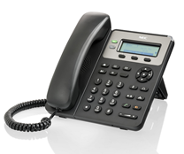






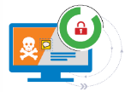



UNIVERGE SL2100 – Interfaces
PSTN
ISDN
Analogue Terminals
Home worker
SIP Carrier
ISDN PRI/BRI Trunks
Analogue Trunks
SIP Trunks
WAN
Digital Terminals
IP Terminals
Networking
SIP Terminals
Built-in Applications
WiFi Terminals
DECT Terminals
Doorphone

Slide 44
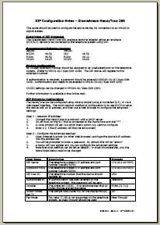
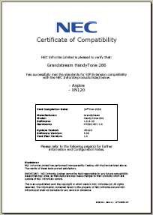
UNIVERGE SL2100 - SIP Trunks
SIP Trunks
  SIP Trunks Certification procedure.
  PCPro includes profiles for certified carriers for easy configuration
  NEC are continuously testing with various carriers.
  Requests can be logged on the MRDB by Account Manager or through Distribution Partners.
  Certificates are created for all successful tests.
  Latest versions can be downloaded from Businessnet or from Distribution partners support portal.
  Many Carriers certified already.
    Blueface (Ireland) VoIP Ireland (Rep. Ireland)
    Clarity Telecom (Ireland) Voicedata (Netherlands)
    Club Communications (UK) 3StarsNet (Belgium)
    Gamma Telecom (UK) More to be certified.
    IP DirectConnect IPDC v1
    IP DirectConnect IPDC v3.1
    Infopact (Netherlands)
    Node4 SIPLink (UK)
    Primus (Belgium)
    Sonofon (Denmark)
    Teleware (UK)
    Toplink (Germany)
    Visual Online (Luxembourg)
    Voice Flex (UK)

Slide 45

UNIVERGE SL2100 – Application Interfaces
Application Interfaces – using PC or Server to host the application
PC or Server running the applications connected to SL system
Call Logging records
Real Time events
CTI
Hotel PMS
System configuration data (PCPro)

Slide 46
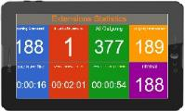
UNIVERGE SL2100 – Built-in Applications
Built-in Applications – SL2100 hosts the application
  Customer uses web browser to access the application from PC or Android tablet
  InGuard – Toll Fraud detection and prevention
  InReports – Call logging and reports
  InUC – Web video, document sharing and IM
  InHotel – Hotel Front of House, reservations and billing
  InFIAS – FIAS V2.21 compatible messaging for PMS
InUC
Web browser to access the built-in application
Call Logging records
XML Pro
System Configuration Data (WebPro)
Hotel PMS

Slide 47

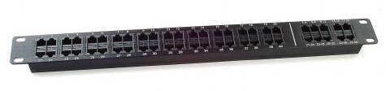
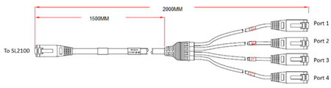

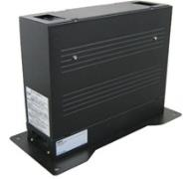
UNIVERGE SL2100 – Installation
Installation
  System Mounting – Rack or Wall
  Total 3U rack space required includes ventilation
  Patch Panels – RJ61 -> RJ45, 16, 24 or 40 Port
  Cables and Adapters
  SL2100 cards have RJ61 connectors with multiple ports per connector, the panel/cable/adapter breaks out to RJ45 connections with one port per connector
  Battery Backup (external battery box)

Slide 48
Terminals

Slide 49

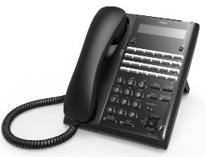
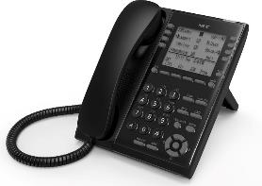
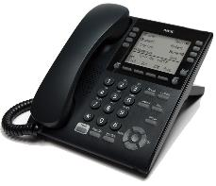
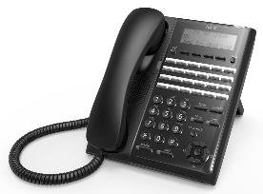
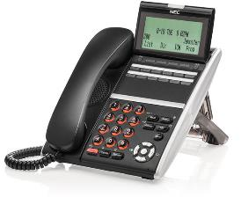
SL2100 Platform Terminals – Type A, Type B and IP range
Digital *
IP
Type A
or
Type B
DT430
8IPLD
DT820
GT210
* System can have either Type A or Type B terminals, not both
Notes:
The system will be set to 2 wire terminal (Type B) connection when the main KSU has an 082 card installed. When no 082 card is installed the system will operate in 4 wire mode (Type A).

Slide 50
UNIVERGE SL2100 – Type A & Type B Terminal Comparison
SL2100 can have either Type A or Type B terminals
  It is not possible to install both types to the same SL2100 system
Overview of differences between each terminal type
 | Type A | Type B
Connection | 4 wire (Hybrid) to 308 or 008 card | 2 wire (Digital) to 082 card
Display | 2 lines x 16 digit, no backlight | 3 lines x 24 digit with backlight
Soft keys | None | 4
Handsfree | Half Duplex | Full Duplex
Headset port | No | Yes
EHS support | No | Yes
DSS console type | 4 wire type (DSS-A) | 2 wire type (DSS-B)

Slide 51
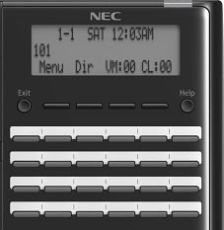
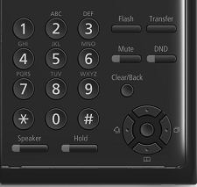
UNIVERGE SL2100 – Terminal Features
Function Keys
Service Codes
Fixed Feature Keys
The function keys can be used for various purposes, such as selecting a line, performing a feature or showing a status, etc.
Over 110 possible features can be programmed onto these feature keys so the most important to you are ready at your fingertips.
Over 170 features can be accessed via service codes dialled from the keypad. Items such as, Call forward, Call Pickup, etc.
Six fixed feature keys for Handsfree, Hold, Trunk Flash, Transfer, Microphone mute & DND
Type B terminal shown

Slide 52
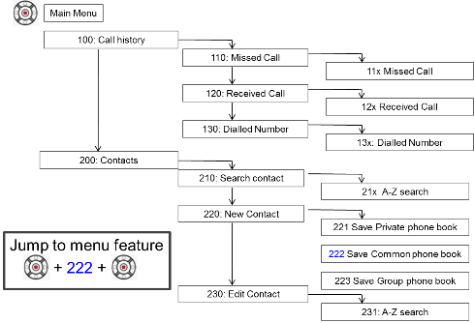
UNIVERGE SL2100 – Terminal Features
Navigation Keys
In Context LCD Prompts
Type B & 8IPLD Terminals only
The items on the bottom row of the display change to provide the most context sensitive options depending on the phone state.
Pressing one of the 4 soft keys directly below choose the respective function.
Type B terminal shown

Slide 53
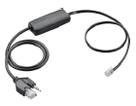
Terminal Modules
Add on Modules
  60-line DSS Console
  The Type A, Type B and 8IPLD terminals can have a 60 button console assigned
  Wireless Headset Adapter (WHA)
 | DSS-A | DSS-B
Connection | 4 wire (Hybrid) to 308 or 008 card | 2 wire (Digital) to 082 card
Programmable Keys | 60 | 60
Lamp colour | Red/Green | Red/Green
Capacity | 9 (3 per KSU) | 12 (no restriction per KSU)
 | Type B | 8IPLD
WHA Adapter | DX7-NA-WHA | APD-80
Notes:
For the 8IPLD IP terminal the choice of DSS-A or DSS-B is determined by the installation of the 082 card in the main KSU.
082 card installed = DSS-B
082 card NOT installed = DSS-A

Slide 54
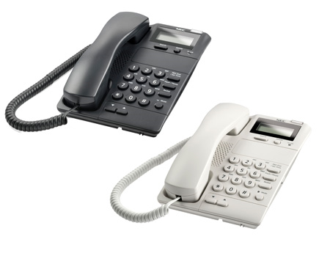
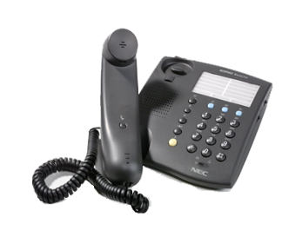
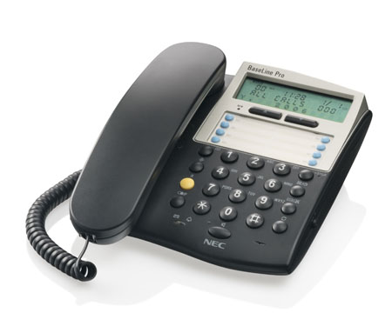
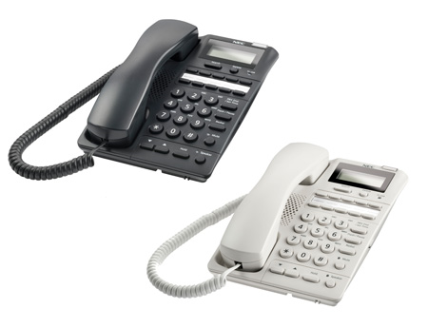
Analogue Terminals
Analogue
BaseLine
BaseLine Pro CLI
AT50
AT55

Slide 55
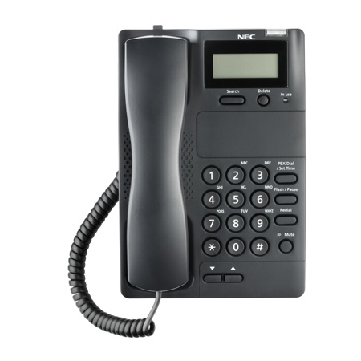
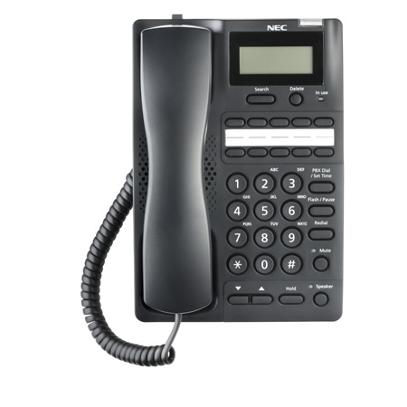
AT50 & AT55 Analogue Terminals
AT50 and AT55 Analogue Terminals
  Available for connection to the SL2100
 | AT50 | AT55
Description | Simple Caller ID phone | Multifunctional Caller ID Phone
LCD | 2 x 16 digit | 2 x 16 digit
Message Waiting Lamp | Yes | Yes
Handset volume control | Yes | Yes
Caller list | 30 | 90
In use lamp | Yes | Yes
One touch speed dials | None | 10
Hearing Aid Compatible | Yes | Yes
Speaker phone | No | Yes
Require batteries | No | No
Wall mountable | Yes (no bracket required) | Yes (no bracket required)
Colours available | Black/white | Black/white
AT50
AT55

Slide 56
Standard SIP Terminal
Standard SIP
GT210

Slide 57
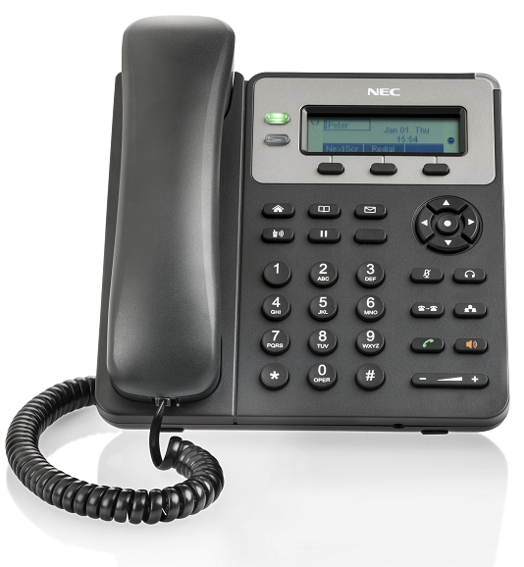
GT210 Standard SIP Terminal
GT210 Standard SIP Terminal
  The GT210 Standard SIP terminal is available for connection to the SL2100
 | GT210
License | EU909388 – SL2100 NEC SIP License
Line Keys | 2 | 1 SIP account supported
Soft keys | 3 | Context sensitive
Lamp colour | Red | Voicemail message waiting
Capacity | 112 | Total for all IP terminals
LAN ports | LAN & PC port | 10/100Mbps
Headset | RJ9 headset jack | Plantronics EHS supported
Provisioning | Yes | XML file
Power supply | PoE (Class 2) or optional PSU
Handsfree | Full duplex
Phonebook | 500 contacts
Languages | Multi language
Wall/Desk mount | 2 step desk stand / wall mounting

Slide 58
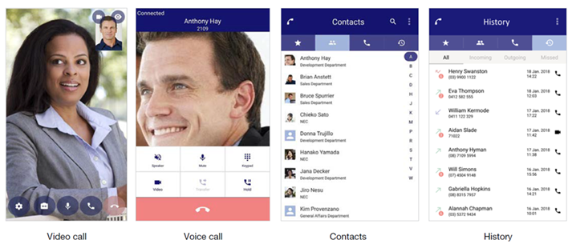
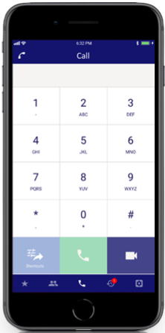
Standard SIP Smartphone Application
Standard SIP
ST500

Slide 59
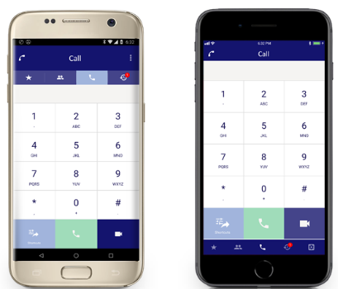
ST500 Smart Mobile Application
ST500 Smart Mobile Application
  The ST500 Smart Mobile Application is available for connection to the SL2100
  NEC’s UNIVERGE ST500 is developed for Apple iPhone, iPad and Android smart devices lets you leverage native contact lists to make and receive voice and video calls. Simply connect to Wi-Fi or use your mobile data (3G/4G) to handle your calls.
 | ST500
SL2100 License | EU909388 – SL2100 NEC SIP License
Smart Phone OS | iOS 11.0.3+ or Android 4.0.3+ (4.4 for video)
Network | Wi-Fi, 3G/4G
Protocol | SIP, SIPS/TLS, SRTP | SIPS/TLS is available with SL2100 R1.8 Main Software release
Call Features | Male/Answer/Call Waiting Hold/Transfer/Conference Call Park, Call Pickup, Call Forward, Call hunt groups | Bluetooth headset support Integrates with smartphone’s contacts Localised dial plan
Voice calling | Codec support: OPUS, G.722.1, G.711, G.722, G.729a
Video calling | Codec support: H.264 / AVC
iOS Push Notification | Supported with SL2100 R1.8 Main Software release

Slide 60
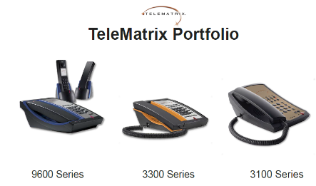
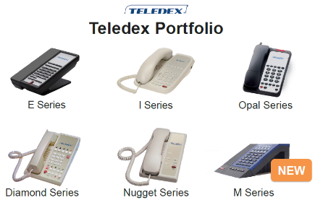
Hotel Terminals
Cetis Terminals
Analogue and SIP terminals for the hotel environment
Only available to selected regions, refer to your channel manager for details

Slide 61
Call Routing

Slide 62
UNIVERGE SL2100 – Call Routing
Station Groups
  Internal/external calls ring at idle members within the group
Multi Device Groups
  Users can have more than one device under a single extension number, all devices work as one extension
Ring Groups
  External calls ring at all members of the group
  Delayed ringing available with SL100 R2 Main Software release
UCD
  Station Groups provide options to share calls between members of the group
  Group members can choose to log-out of the group
Virtual Extensions
  Software extensions can be assigned to the programmable function keys and be used for incoming/outgoing call routing – giving the user multiple extension appearance
Mobile Extension
  Your mobile phone becomes and extension on the system, calls can be made/received at the mobile phone as if it is an extension within the system

Slide 63
UNIVERGE SL2100 – Call Routing
DDI
  Direct Dial In for ISDN and SIP trunks allows flexible call routing to any group or extension
  If you’re busy or the call isn’t answered it can step to another extension, a group, your voicemail box or your mobile phone
DIL
  Direct Inward Lines are used to route external calls directly to your extension
DISA/DUD (Automated Attendant)
  External calls are answered by the system with a greeting message that prompts the caller to choose their option for call routing
  Calls can be routed to your extension number, groups, voicemail or an external number
  The user can record their own greetings or they can upload professionally recorded ones
F-Route
  Flexible number routing allows the system to convert the dialled number and route to defined destinations, for example you may want users to dial extension 501 and the call actually dials out to a mobile phone number
  Can be used for all dailled numbers, DDI’s, Automated Attendant etc
Virtual Loopback
  Software trunks within the system can be used for almost unlimited call routing options!
  Internal or Automated Attendant calls can be routed as if it were an external call
  DDI routing can be applied to non-DDI analogue trunks

Slide 64
IVR

Slide 65
UNIVERGE SL2100 – IVR (Interactive Voice Response)
VRS (Voice Response System)
  4 channels built in with 100 messages, 1 prompt language (no SD card required)
  Can be expanded to 16 channels by installing the EXIFB card
  Adding the SD card will provide multiple language selection (26 languages)
InMail Voicemail
  CPU-C1-A has 4 channel built in voicemail with 2 hours storage, 1 prompt language (no SD card required)
  128 User Mail boxes
  Auto-attendant functionality
  Optional choice of 15 or 120 hours storage dependent on SD card purchased, SD Card sits on the CPU
  Optional voicemail to e-mail (system license required)
3rd Party Voicemail Integration
  Uses DTMF signalling on analogue ports to allow 3rd party voicemail to connect

Slide 66
Conferencing

Slide 67

UNIVERGE SL2100 – Conferencing
Conference
  Add in other users into your call to create a conference call. Up to 16 internal/external users can be included.
PSTN
Conference Bridge
A user adds in other users to their conference

Slide 68
UNIVERGE SL2100 – Conferencing
Remote Conference
  Each user dials the Remote Conference pilot number to create a conference call. Up to 16 internal/external users can be included.
“1234”
PSTN
“1234”
“1234”
Conference Bridge
Each users dials in to the Remote Conference number and enter the password number to join
“1234”

Slide 69
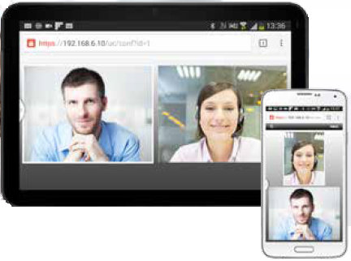
UNIVERGE SL2100 – Conferencing
Web Video Conferencing
Video conferencing, document & screen sharing for up to 32 (4 groups of 8 users).
Direct connection from the SL2100 via your browser.
Highly cost-effective solution
Uses secure connectivity
Works via Google Chrome or Internet Explorer v11 on a Windows based PC or Android device

Slide 70
Hospitality

Slide 71
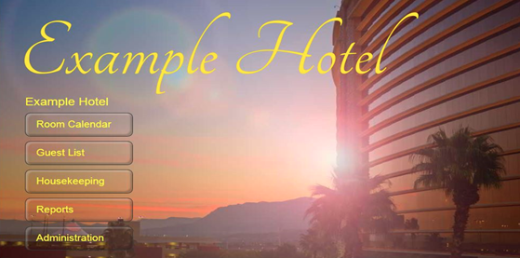
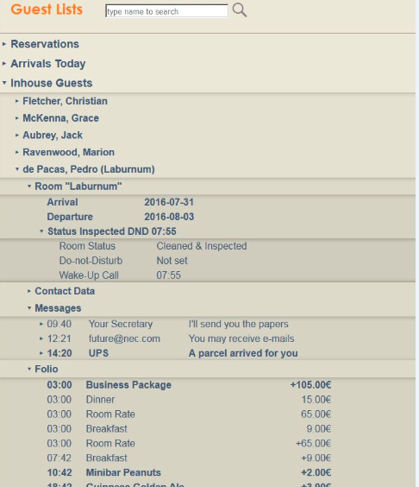
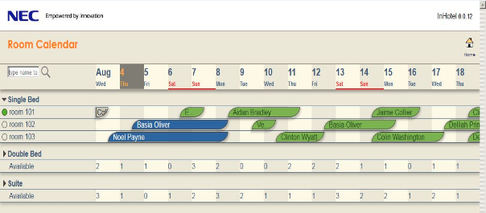
UNIVERGE SL2100 – Hospitality
InHotel
Hotel Front Of House (FOH) run directly from the SL2100 via browser (Chrome, Firefox, Internet Explorer 11, Edge).
Perfectly suited to the smaller hotel where value is key.
Room booking, billing & hotel administration

Slide 72
UNIVERGE SL2100 – Hospitality
InHotel Property Management Features:
Up to 64 rooms (4 & 16 room licenses available)
Room allocation - See current and future guests on a colour coded calendar view
Jump to date - Quick access to any future date
Guest filter - Easily find a guest reservation or stay using the filters
Room Management - See colour coded status of all rooms (clean/dirty/out of order)
Folio Management - Add charges for services and products to guest folio
Invoice Generation - Complete invoice generation for room nights, services & telephone calls
Message Service - Capture messages for guests with automatic room notification
Flexible Room Rates - Based on calendar dates or days of week
Multiple Connections – No license for additional connections, folio items can be added by housekeeping or restaurant
Guest Stay Information – Capture information about the guest, contact details and stay reasons; opportunity to build CRM database of guests
Custom Products & Services – Can be created & added to guest folio

Slide 73
UNIVERGE SL2100 – Hospitality
InHotel Telephony Features
Checkin/Checkout Functions – Automatically control telephone restrictions
Guest Name Display – Guest name is transferred when the guest checks in, displayed on reception phone when a call is received from the room
Telephone Billing – All calls are captured and billed against the guest folio
Flexible Rates – Custom rates can be configured to allow the hotel to set their own call rates
Multiple Telephones – Multiple telephones can be grouped into a single room and billed to a single guest stay
Hotelier Control – The hotelier can set call restrictions (local only/local & national/ international), block room to room calls and set Do Not Disturb feature from the hotel console
Centralised Wakeup Call Management – Wakeup calls can be set by the guest or hotelier & managed, modified or cancelled within InHotel

Slide 74

UNIVERGE SL2100 – Hospitality
Voice Mail Options for Hospitality
  InMail
    Built in InMail on the CPU-C1-A has 4 channels & 2 hour storage
    Adding the SDVMS card provides 15 hours storage
  On room check-in, the guest mailbox:
    Cleared of messages
    Mailbox language is reverted to default
    Mailbox greetings are erased
    Room name is deleted
    Security code is deleted

Slide 75
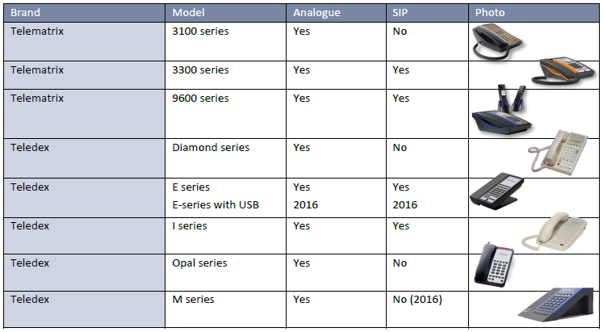
UNIVERGE SL2100 – Hospitality
CETIS
Large terminal range for the hotel environment
Selected regions only

Slide 76
Unified Communication (UC)

Slide 77
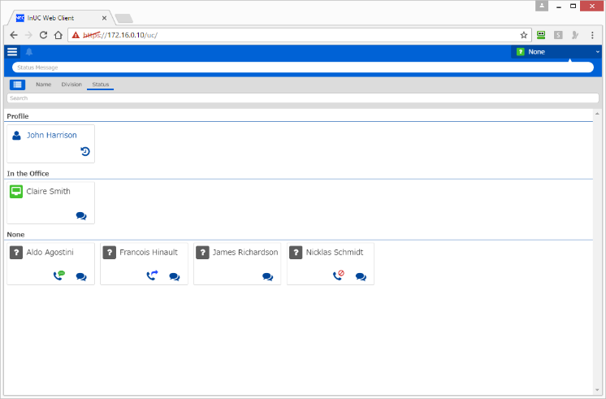
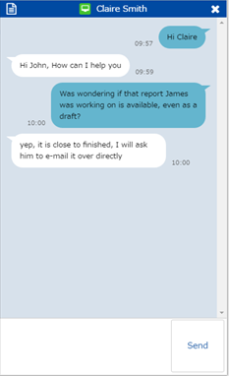
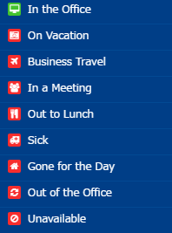
UNIVERGE SL2100 – UC
InUC
  The InUC Client application is accessed directly from the SL2100 using a browser.
  Offering Presence, Busy Lamp (BLF), Instant Messaging (IM), Deskphone Control and Browser Phone.
  Easy access to the web video conferencing and screen sharing

Slide 78
Operator Console

Slide 79
UNIVERGE SL2100 – Operator
Phone + DSS console
  Still the preferred method of working by traditionalists.
  Each key representing an extension, showing its status (BLF). A single press calls the extension.
Phone
  For smaller size systems the DSS console may not be required.
  The same DSS functionality can be found on the Programmable Function keys on the 12 & 24 button terminals

Slide 80
Call Logging/Reporting

Slide 81
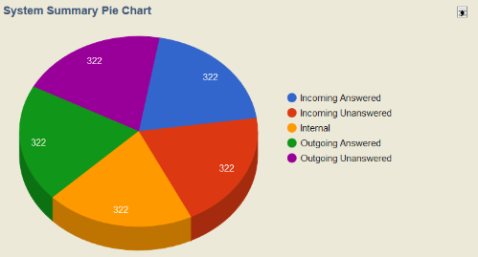
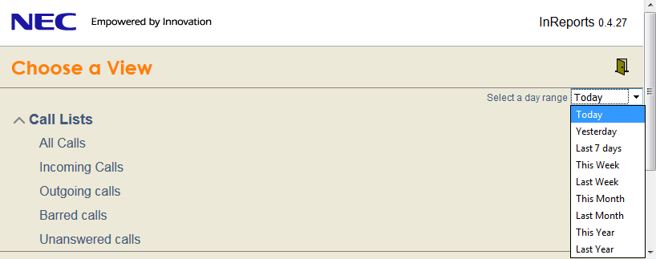
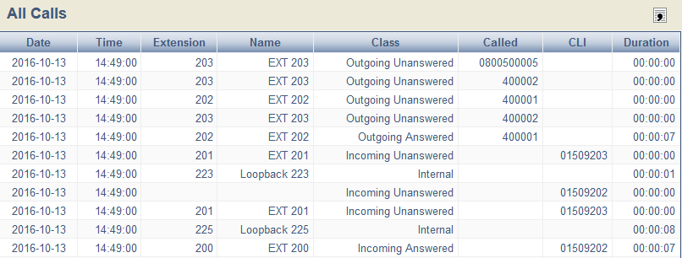
UNIVERGE SL2100 – Call Logging/Reporting
InReports
  InReports is a reporting application giving you vital statistics on the effectiveness of your telephone system.
  Call Lists, Reports, Graphical Data and Wallboards can be viewed in a Web Browser!
  As the application runs on the system, no external server is required to access the data!
  All of the data in InReports can be exported to a csv file to allow detailed data manipulation.
  Calls are stored for a maximum of 1 year and any calls over this age are automatically deleted.

Slide 82
UNIVERGE SL2100 – Call Logging/Reporting
MyCalls Call Manager
Call Manager functionality such as:
  Multiple users
  Call Recording Module support
  More reports
  Customisable reports
  Report scheduling
  Call costing
  Alarms
A ‘real-time’ view of call activity in easy to view screen display and report formats
How many calls received
How many calls abandoned
How many calls made
How many staff available to answer calls
Conversation length and more
Call statistics & Alarms

Slide 83
Call Recording

Slide 84


UNIVERGE SL2100 – Call Recording
InMail
Calls can be recorded into a user’s mailbox, either automatically, or by pressing a record key.
The voicemail can be listened to by calling the Voicemail, or InMail can e-mail the message to your e-mail address, the automatic message delete option will keep the InMail storage capacity available.
PSTN
Built-in InMail can be used for call recording (2 hour storage).
Storage can be increased by adding the SDVMS card
Press RECORD KEY (programmable Function key)
Mailbox 200
Ext 200

Slide 85
UNIVERGE SL2100 – Call Recording
MyCalls
Record all your external calls via MyCalls Call Recorder.
As part of the MyCalls suite and built on the Call manager it gives a single interface for all reports and recordings, making search and find very easy.
Supports SIP, ISDN and Analogue trunks.

Slide 86
Networking

Slide 87


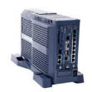
UNIVERGE SL2100 – Networking
SIP Networking
Using SIP Trunks in networking mode allows much better connectivity options in terms of platforms in the network.
Up to 1000 connections are available.
SL2100
PSTN
SV9100
SL1000 / SL1100
WAN
PSTN
PSTN
PSTN
SV8100

Slide 88
UNIVERGE SL2100 – Networking
SLNet Networking
Using SLNet Networking provides these features
Up to 50 nodes are available
Centralised voicemail
Desk to Desk dialling with Caller ID and name
Sharing trunk lines at remote systems
Extension busy lamp information
Shared Park Hold orbits
Available for SL2100 systems only
Point to Point connection required (eg VPN, MPLS)
SL2100
PSTN
SL2100
SL2100
WAN
Centralised voicemail
SL2100

Slide 89
Mobility

Slide 90
SL2100 InUC

Slide 91
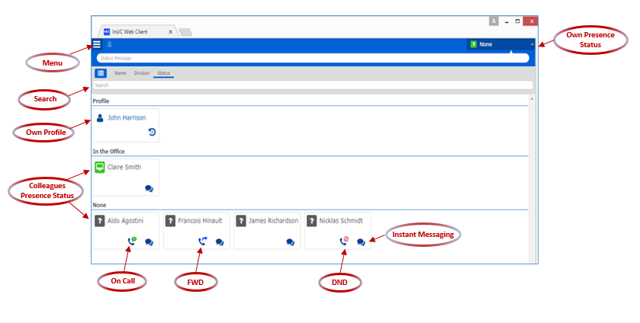

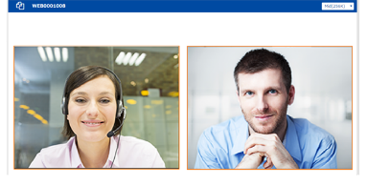
SL2100 InUC
InUC client
Web Browser interface
  No Server required
  No Application install
  Chrome and IE11 for Windows
  Chrome for Android OS
In-UC Presence, Editable buddy list, BLF
Instant Messaging
E-mail functionality
Display of Speed dial list
Web Video Conference easy access
Multicast Message
Multicast Mail

Slide 92
IP DECT

Slide 93
UNIVERGE IP DECT
IP DECT on the SL2100
Take advantage of the 8 built in IP resources
IP DECT Lite Manager does not require a PC on site
  Up to 10 low cost AP400S Access Points or up to 32 AP400C/E Access Points
  Up to 16 DECT handsets* (typical quantity based on fair usage with the 8 built in IP resources)
  DECT handsets require SL2100 licenses (CPU-C1-A has 4 IP extension licenses included)
Use Multi Device Group if the user wants a desk phone plus DECT handset with a single extension number
  * Quantity of DECT handsets can be increased up to the maximum of 64, but it is recommended that the optional VOIP card and IP Resource license(s) are installed to provide additional IP resources.

Slide 94
UNIVERGE IP DECT Access Points
The AP400 comes available in the following types:
  AP400S – Very low cost unit, typically for SL2100
  AP400C – Lower cost SMB product
  AP400E – External version of AP400
 | SL2100
 | IP DECT Lite Manager |  | IP DECT Full DAP Manager
Type of AP | AP400S | AP400C (AP400/E) | AP400S | AP400C | AP400 (E)
# Access Points | 10 | 32 | 10 | 256 | 256
# Handsets | 64 | 64 | 112 | 112 | 112

Slide 95
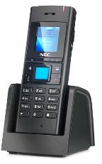




UNIVERGE IP DECT handsets
DECT Handsets
Full range of DECT handsets to fit all requirements:
IP DECT
G266
G566
G966
I766
M166

Slide 96

UNIVERGE IP DECT handsets
DECT Handsets
Comparison of Handset types:

Slide 97
WiFi handsets

Slide 98


WiFi handset Spectralink 8400
Spectralink 8400
Spectralink Wireless handsets improve productivity and responsiveness for on-site
mobile professionals
  8400 Series – 8440 handset only
  Succeeding MH150/160
    Standard SIP protocol only (no ISIP/NSIP)
    No SVP server
    OAI server supported mainly for backward compatibility
  Handsets will not be rebranded to NEC
  NEC portfolio: black versions, no Lync support
  XML integration with applications (like messaging and central directory)
  Standard SIP protocol Display
    2.2” (55.9 mm) - 240x320 res. - 65,000 colour palette
  Buttons
  Push-to-TalkPanic/Duress

Slide 99
UNIVERGE Mobile Extensions

Slide 100
Mobile Extension
Mobile Extension
By assigning your mobile number to system extension port (mobile extension port) it can be used as if it were an extension directly connected to the system.
Mobile Extension does not require any application on your phone or data connectivity (eg 3G/4G or WiFi)
Benefits:
The mobile can call in to the system to make calls to other extensions, or even perform service code functionality.
Can use the SL2100 call routing options (Ring Groups, Station Groups etc)
Give single contact number to your customers (ie your office DDI number) so you are always contactable
Place calls from your mobile via the SL2100 and customers will see your office number as their Caller ID
Incoming caller’s Caller ID can be passed to your mobile (if supported by your SIP Network provider)
The Mobile Extension can be any phone number, does not need to be a mobile phone, so you could have your home phone setup as your ‘Mobile Extension’

Slide 101
Security and Encryption

Slide 102



UNIVERGE SL2100 – Security
InGuard
The Toll Fraud Guard is an active call monitoring application that can be used to help prevent toll fraud from happening.
The guard runs on the SL2100 and is accessed via a web browser, therefore no server required.
When potential fraudulent activity takes place the guard can send email notifications to users informing them of the suspicion.
The System Health Check is a built in feature that can look at the configuration of the PBX and show if any areas may leave the PBX vulnerable to attack in different ways. This can prompt an installer to make sure adequate precautions are taken when enabling features on the system. Each of the checks will be displayed green, yellow or red depending on the result of the test.

Slide 103

UNIVERGE SL2100 – Security
MyCalls
Alarms can notify you to potential issues on the SL2100.
Alarms Types:
  System Alarm - will notify you when there has been no SMDR output for a number of minutes.
  Emergency Alarm - will notify if a user dials an emergency number.
  Call Rate Alarm - will notify you if the number of incoming, abandoned or outgoing call rate over the last hour goes under or over a certain amount, example:
      Over 20 abandoned calls in the last hour.
      Under 100 outgoing calls per hour.
      Over 50 incoming calls per hour.
Alarms are sent to the MyCalls application or can be sent as SMS messages.

Slide 104

UNIVERGE SL2100 – Security
Toll Restriction
Quick and easy overview of all the toll restrictions for all extensions.
Even test how an outbound number would be treated:
Test the Toll Restriction via PCPro

Slide 105


UNIVERGE SL2100 – Encryption
Encryption
  TLS SIP Trunks and Extensions
    (TLS for Standard SIP Extensions added SL2100 R1.8 Main Software release)
  sRTP
  NEC SIP Extensions
    (TLS for Standard SIP Extensions added SL2100 R1.8 Main Software release)
TLS

Slide 106
Maintenance

Slide 107


UNIVERGE SL2100 – Maintenance
PcPro
  Application allowing enhanced programming functionality with ease
  Allow offline programming so can build up a site configuration anywhere, anytime
  Configuration backup and upload to another system
  Initial Setup wizard for quick installation of the system

Slide 108


UNIVERGE SL2100 – Maintenance
WebPro
UserPro
Make changes to the system configuration via Web browser
Make changes to a user configuration via Web browser

Slide 109




UNIVERGE SL2100 – Maintenance
  TelPro
  Diagnostics Interface
  Alarming
Make changes to a user configuration via NEC terminal (TelPro)
Select items to monitor for Diagnostics interface
System alarm report

Slide 110


10 Business Benefits of the SL2100

Slide 111

7 great reasons to become an NEC Business Partner

Slide 112

7 great reasons to become an NEC Business Partner

Slide 113

Why On-premise?

Slide 114

Why On-premise?

Slide 115

Why On-premise?

Slide 116

Why NEC?

Slide 117


More Information
For more information about NEC and all its products, the following sites are available:
For all:
For Partners:
https://www.nec-enterprise.com/
http://businessnet.nec-enterprise.com/Pages/Home.aspx

Slide 118
SL2100 Details – Hardware List
Part Code | Description
BE116494 | IP7WW-4KSU-C1 w/o C | SL2100 Main/Expansion KSU CPU/EXIFE slot + 4 universal slots
161893001-A | SL2100 Rack Mount Shelf | 19 inch Rack Mount shelf for SL2100 KSU (3U total)
BE110239 | IP4WW-Battery Box | SL external Battery box (batteries not included)
BE116498 | IP7EU-CPU-C1 | SL2100 CPU-Basic (No InMail built-in)
BE117657 | IP7EU-CPU-C1-A | SL2100 CPU-Advance (2hr InMail+4SIP trunks+4IP Extns built-in)
BE116500 | IP7WW-VOIPDB-C1 | SL2100 VOIP expansion card (16ch included)
BE116501 | IP7WW-EXIFB-C1 | SL2100 Expansion interface card (installed into Main KSU). Also increases VRS/InMail to 16 channels
BE116502 | IP7WW-SDVMS-C1 | SL2100 15hr storage for InMail
BE116503 | IP7WW-SDVML-C1 | SL2100 120hr storage for InMail
BE116504 | IP7WW-EXIFE-C1 | SL2100 Expansion interface card (installed into each expansion KSU)
Note - Not all parts may be available within your region

Slide 119
SL2100 Details – Hardware List
Part Code | Description
BE116505 | IP7WW-308U-A1 | SL2100 3 analogue trunk + 8 Hybrid extensions + Audio interfaces Hybrid interfaces support the connection of Type A terminals or analogue SLT terminals
BE116506 | IP7WW-082U-B1 | SL2100 8 Digital extension + 2 SLT extensions (accepts trunks daughterboard) + Audio interfaces Digital interfaces support the connection of Type B terminals
BE116507 | IP7WW-008U-C1 | SL2100 8Hybrid/SLT extensions (accepts trunks daughterboard). Hybrid interfaces support the connection of Type A terminals or analogue SLT terminals
BE116509 | IP7WW-000U-C1 | SL2100 Carrier card for trunk daughterboards
BE116510 | IP7WW-3COIDB-C1 | SL2100 3 channel analogue trunk daughterboard
BE116511 | IP7WW-2BRIDB-C1 | SL2100 2 circuit (4ch) Basic Rate daughterboard
BE116512 | IP7WW-1PRIDB-C1 | SL2100 1 circuit (30ch) Primary Rate daughterboard
Note - Not all parts may be available within your region

Slide 120
SL2100 Details – License List
Part Code | Description
BE116744 | SL2100 IP CHANNEL-16 LIC | SL2100 Additional 16ch VOIP license, must have VOIPDB card installed
BE116745 | SL2100 IP TRUNK-01 LIC | SL2100 IP trunk license 4 Included with the CPU-C1-A
BE116746 | SL2100 IP EXT-01 LIC | SL2100 IP extension license for 3rd Party or NEC devices (not required for 8IPLD IP terminal) 4 Included with the CPU-C1-A
EU909388 | SL2100 NEC SIP License | SIP Extn license for NEC devices (not required for 8IPLD IP terminal)
BE116747 | SL2100 ENCRYPTION LIC | SL2100 Encryption license
BE116750 | SL2100 REMOTE CONF-01 LIC | SL2100 Remote Conference bridge license
BE116751 | SL2100 VM E-MAIL NOTIFY LIC | SL2100 voicemail to e-mail notification license
BE116753 | SL2100 HOTEL LIC | SL2100 Hotel feature license
BE116754 | SL2100 PMS LIC | SL2100 Hotel PMS license (also requires SL2100 Hotel license)
BE116755 | SL2100 XMLPRO LIC | SL2100 XMLPro license
BE116756 | SL2100 3RD CTI LIC | SL2100 3rd Party CTI license
BE116757 | SL2100 MOBILE EXT-01 LIC | SL2100 Mobile extension license
Note - Not all parts may be available within your region

Slide 121
SL2100 Details – License List
Part Code | Description
BE116758 | SL2100 IN-UC WEB CLIENT-01 LIC | SL2100 InUC Web client license
BE116760 | SL2100 WEB VIDEO CNF-01 LIC | SL2100 InUC Video Conference license 4 Included with the CPU-C1 & CPU-C1-A
BE117473 | SL2100 IN-UC 1st-01 CTI | SL2100 InUC Client call control license
BE117668 | SL2100 ACD P-EVENT LIC | SL2100 ACD P-event interface license
BE116763 | SL2100 OnBoard App. InGuard Lic | SL2100 OnBoard App. InGuard License
BE119746 | SL2100 OnBoard App. InReports Lic | SL2100 OnBoard App. InReports License
BE119099 | SL2100 OnBoard Apps InHotel Lic | SL2100 OnBoard Apps InHotel License
BE119738 | SL2100 InHotel 4 Room LIC | SL2100 InHotel 4 Room License
BE119741 | SL2100 InHotel 16 Room LIC | SL2100 InHotel 16 Room License
EU000339 | SL2100 Remote P-Event LIC | SL2100 Remote P-Event LIC
BE118080 | SL2100 InACD | SL2100 InACD 8 groups and 20 agents
BE116748 | SL2100 ASPIRENET-01 LIC | SL2100 SLNet channel
BE117997 | SL2100 IN-UC Web Phone-01 LIC | SL2100 InUC Browser Phone
Note - Not all parts may be available within your region

Slide 122
SL2100 Details – License List
Part Code | Description
BE118324 | SL2100 INFIAS LIC | SL2100 FIAS v2.21 connection to Front of House/PMS applications
Note - Not all parts may be available within your region

Slide 123
SL2100 Details – Terminals
Part Code | Description
BE116515 | IP7WW-12TXH-B1 TEL(BK) | SL2100 12 button TXH-B terminal (2wire digital) black
BE116516 | IP7WW-24TXH-B1 TEL(BK) | SL2100 24 button TXH-B terminal (2wire digital) black
BE116513 | IP7WW-12TXH-A1 TEL(BK) | SL2100 12 button TXH-A terminal (4wire hybrid) black
BE116514 | IP7WW-24TXH-A1 TEL(BK) | SL2100 24 button TXH-A terminal (4wire hybrid) black
BE116517 | IP7WW-8IPLD-C1 TEL(BK) | SL2100 32 button Desiless IP terminal black
BE115113 | ITY-6D-1P(BK)TEL | DT820 6 button IP terminal black
BE115114 | ITY-8LDX-1P(BK)TEL | DT820 8 button Desiless IP terminal black
BE113862 | DTZ-12D-3P(BK)TEL | DT430 12 button terminal (2wire digital) black
BE113864 | DTZ-24D-3P(BK)TEL | DT430 24 button terminal (2wire digital) black
BE116518 | IP7WW-60D DSS-A1 CONSOLE (BK) | SL2100 60 button TXH-A console (connects to hybrid interface) black
BE116519 | IP7WW-60D DSS-B1 CONSOLE (BK) | SL2100 60 button TXH-B console (connects to digital interface) black
BE109741 | DX4NA Doorphone | Doorphone unit (connects to analogue extension interface)
Note - Not all parts may be available within your region

Slide 124
SL2100 Details – Terminals
Part Code | Description
EU915102 | Baseline Pro with CLI | Baseline Pro analogue terminal
BE118842 | AT-50P(WH) TEL | AT-50 simple analogue CLI terminal (White)
BE118843 | AT-50P(BK) TEL | AT-50 simple analogue CLI terminal (Black)
BE118844 | AT-55P(WH) TEL | AT-55 Multifunctional analogue CLI terminal (White)
BE118845 | AT-55P(BK) TEL | AT-55 Multifunctional analogue CLI terminal (Black)
BE117876 | ITX-1615-1W(BK)TEL | GT210 Standard SIP terminal
Note - Not all parts may be available within your region

Slide 125
SL2100 Details – Terminal sheets
Part Code | Description
Q24-FR000000127919 | DESI SL2100 12TXH-B (PKG 25) | Pk25 DESI labels for 12TXH-B terminal (English)
Q24-FR000000127920 | DESI SL2100 24TXH-B (PKG 25) | Pk25 DESI labels for 24TXH-B terminal (English)
Q24-FR000000127921 | DESI SL2100 DSS (PKG 25) | Pk25 DESI labels for DSS console (Blank)
Q24-FR000000127922 | DESI SL2100 8IPLD (PKG 25) | Pk25 DESI labels for 8IPLD terminal (English)
A50-FR000000127919 | DESI SL2100 12TXH-A (PKG 25) | Pk25 DESI labels for 12TXH-A terminal (English)
A50-FR000000127920 | DESI SL2100 24TXH-A (PKG 25) | Pk25 DESI labels for 24TXH-A terminal (English)
660140-A4 | DESI Labels for ITY-6D | DESI labels for ITY-6D
A50034060001 | DESI labels for DT430/830-12/24Btn | DESI labels for DT430/830 – 12/24 button
Note - Not all parts may be available within your region

Slide 126
SL2100 Details – Cables, Adapters & Panels
Part Code | Description
LPNEC2 | Cable-C 2p4w | Converts one RJ61 plug to two x 4wire RJ45 plugs 308/008 card Hybrid or SLT interfaces, 082 card SLT interface
LPNEC3 | Cable-B 3p2w | Converts one RJ61 plug to three x 2wire RJ45 plugs 308/3COIDB card analogue trunk interface
LPNEC4 | Cable-A 4p2w | Converts one RJ61 plug to four x 2wire RJ45 plugs 082 card Digital, analogue extension or audio interfaces, 308 card Audio interface
ADNEC14 | Adapter-A 4p2w | Converts one RJ61 socket to four x 2wire RJ45 sockets 082 card Digital, analogue extension or audio interfaces, 308 card Audio interface 308/3COIDB card analogue trunk interface
ADNEC24 | Adapter-C 4p4w | Converts two RJ61 socket to four x 4wire RJ45 sockets 308/008 card Hybrid or SLT interfaces, 082 card SLT interface
FFV16NECBK | 16 Port RJ45 Patch Panel, Black | 16 port patch panel (RJ61 to RJ45) 082 card Digital, analogue extension or audio interfaces, 308 card Audio interface
FFV24NECBK | 24 Port RJ45 Patch Panel, Black | 24 port patch panel (RJ61 to RJ45). 082 card Digital, analogue extension or audio interfaces, 308 card Audio interface
FFNEC50 | 40 Port RJ45 Patch Panel, Black | 40 port patch panel (RJ61 to RJ45). 082 card Digital, analogue extension or audio interfaces, 308 card Audio interface
Note - Not all parts may be available within your region

Slide 127
SL2100 Details – MyCalls Overview
Part Code | Description
EU500003 | LK-SL2100-MyCalls-Call Manager | LK-SL2100-MyCalls-Call Manager
EU500095 | LK-SL2100 MyCalls-Desktop 5 User | LK-SL2100 MyCalls-Desktop 5 User
EU500096 | LK-SL2100 MyCalls-Desktop 10 User | LK-SL2100 MyCalls-Desktop 10 User
EU500097 | LK-SL2100 MyCalls-Desktop 25 User | LK-SL2100 MyCalls-Desktop 25 User
EU500034 | LK-SV9100-MyCalls-Console 1 User | LK-SV9100-MyCalls-Console 1 User
EU500135 | LK-SL2100 MyCalls-Rec 4Ch Ana | LK-SL2100 MyCalls-Rec 4Ch Analogue call recorder
EU500136 | LK-SL2100 MyCalls-Rec 8Ch Ana | LK-SL2100 MyCalls-Rec 8Ch Analogue call recorder
EU500137 | LK-SL2100 MyCalls-Rec 4Ch Dig | LK-SL2100 MyCalls-Rec 4Ch Digital call recorder
EU500138 | LK-SL2100 MyCalls-Rec 8Ch Dig | LK-SL2100 MyCalls-Rec 8Ch Digital call recorder
EU500139 | LK-SL2100 MyCalls-Rec 16Ch Dig | LK-SL2100 MyCalls-Rec 16Ch Digital call recorder
EU500142 | LK-SL2100 MyCalls-Rec 30Ch Dig | LK-SL2100 MyCalls-Rec 30Ch Digital call recorder
EU500159 | LK-SL2100 MyCalls-Rec 4Ch SIP | LK-SL2100 MyCalls-Rec 4Ch SIP call recorder
EU500160 | LK-SL2100 MyCalls-Rec 8Ch SIP | LK-SL2100 MyCalls-Rec 8Ch SIP call recorder
EU500161 | LK-SL2100 MyCalls-Rec 16Ch SIP | LK-SL2100 MyCalls-Rec 16Ch SIP call recorder
EU500162 | LK-SL2100 MyCalls-Rec 30Ch SIP | LK-SL2100 MyCalls-Rec 30Ch SIP call recorder
EU500163 | LK-SL2100 MyCalls-Rec. 60Ch SIP | LK-SL2100 MyCalls-Rec. 60Ch SIP call recorder
Note - Not all parts may be available within your region
This is an overview of MyCalls licenses, there are additional licenses required/available

Slide 128



SL2100 Details – Capacity with Type A Terminals
SL2100 with Type A Terminals connected showing a typical configuration within a single chassis
Analogue Trunks | 12 + 32 + 8IP
Analogue trunks | 12
Digital extensions | 16
Analogue extensions | 16
IP Extensions | 8
These are examples of SL2100 configurations using the four slots available within a single chassis.
IP capacity is non-blocking.
Other configurations are possible.
ISDN BRI Trunks | 16 + 32 + 8IP
ISDN BRI trunks | 16
Digital extensions | 16
Analogue extensions | 16
IP Extensions | 8
ISDN PRI Trunks | 1~30 + 32 + 8IP
ISDN PRI trunks | 1~30
Digital extensions | 16
ISDN PRI Trunks | 20
IP Extensions | 8

Slide 129


SL2100 Details – Capacity with Type A Terminals
SL2100 with Type A Terminals connected showing a typical configuration within a single chassis
SIP Trunks | 4 + 32 + 4IP
SIP trunks | 4
Digital extensions | 16
Analogue extensions | 16
IP Extensions | 4
These are examples of non-blocking IP configurations.
Other configurations are possible.
SIP Trunks | 8 + 32 + 8IP
SIP trunks | 8
Digital extensions | 16
Analogue extensions | 16
IP Extensions | 8

Slide 130



SL2100 Details – Capacity with Type B Terminals
SL2100 with Type B Terminals connected showing a typical configuration within a single chassis
Analogue Trunks | 12 + 36 + 8IP
Analogue trunks | 12
Digital extensions | 16
Analogue extensions | 20
IP Extensions | 8
These are examples of SL2100 configurations using the four slots available within a single chassis.
IP capacity is non-blocking.
Other configurations are possible.
DT430 Terminals are also available in selected regions and have the same capacity as Type B terminals.
A system can have a mix of DT430 and Type B terminals.
ISDN BRI Trunks | 16 + 36 + 8IP
ISDN BRI trunks | 16
Digital extensions | 16
Analogue extensions | 20
IP Extensions | 8
ISDN PRI Trunks | 1~30 + 36 + 8IP
ISDN PRI trunks | 1~30
Digital extensions | 16
ISDN PRI Trunks | 20
IP Extensions | 8

Slide 131


SL2100 Details – Capacity with Type B Terminals
SL2100 with Type B Terminals connected showing a typical configuration within a single chassis
SIP Trunks | 4 + 36 + 4IP
SIP trunks | 4
Digital extensions | 16
Analogue extensions | 20
IP Extensions | 4
These are examples of non-blocking IP configurations.
Other configurations are possible.
SIP Trunks | 8 + 36 + 8IP
SIP trunks | 8
Digital extensions | 16
Analogue extensions | 20
IP Extensions | 8

Slide 132
SL2100 Details - InMail
The SL1100 InMail solution includes the following essential Voicemail and Automated Attendant features.
Voicemail Features
Conversation Recording into personal mailbox | Remote Programming via WebPro/PCPro
Answering Machine Emulation | Auto-Help Voice Prompts
Fax Detection | Auto-Forward to mailbox
Interactive Softkeys (Type B and IP Terminals) | Programmable Individual Security Code
Message Count Display (Type B and IP Terminals) | Real Time and Date Stamp
Programmable Voice Prompts | One-Touch keys for Mailbox Access, Message Retrieval, Message Forwarding
Three Personalized Mailbox Greetings | One-Key Call to Sender
Message Forwarding | Confidential/Urgent/Future Message delivery options
Announcement Mailbox for One-Way Information | Guest & Group/Department mailbox types
Remote or Local Message Notification (on or off site) | Voice to e-mail notification (optional send of wav file)*
Automated Attendant Features
Answer Schedule Tables | Single digit transfer
Park and Page | Individual trunk greetings
Capture Caller ID | Three Day, Night and Holiday Greetings
Flexible answering based on trunk time-of-day and day-of-week

Slide 133
SL2100 Details - InMail
Specifications
CPU-C1-A does not have InMail built in | SDVMS or SDVML memory card can be added to provide InMail with 15/120 hours storage, 4 channels and 26 prompt languages
CPU-C1-A has InMail built in with 2 hours of storage, 4 channels & English prompts | SDVMS or SDVML memory card can be added to increase storage to 15/120 hours and 26 prompt languages
128 Mailboxes
32 Group Mailboxes
32 Routing Mailboxes | 32 Dial Action Tables Instruction Menu, Announcement, Directory & Distribution types available
99 Voicemail messages per mailbox
16 channels available by installing the EXIFB card
Message Upload/Download via UserPro and WebPro
Hotel Integration | Requires SL2100 Hotel license

Slide 134
SL2100 Details - VoIP
The SL2100 has built-in VoIP resources which can optionally be expanded by adding the VOIPDB card.
VoIP
NEC IP Terminals | Using proprietary iSIP protocol with greater feature transparency the SL2100 supports the connection of the 8IPLD and DT820 6D and 8LDX IP terminals
3rd Party IP terminals | Using standards based SIP protocol the SL2100 supports connection of 3rd party IP terminals. Compatibility certificates are available for terminals that NEC have certified for connection to the SL2100
SIP Trunks | Using standards based SIP protocol the SL2100 supports connection to SIP trunks provide by ITSP’s. Compatibility certificates are available for SIP trunk providers that NEC have certified for connection to the SL2100. PCPro also includes wizard setup for SIP carriers
Networking | Networking (networking between telephone systems) is provided by SIP trunks on the SL2100 SLNet provides system features between networked SL2100 systems
VoIP Resources
CPU-C1 and CPU-C1-A have 8 IP resources built in
VOIPDB card can be added to provide 16 IP resources
VOIP Channel license can be added to provide up to 128 IP resources | VOIP channel license provides 16 resources, VOIPDB + 7 licenses = 128 resources total

Slide 135

SL2100 Details - VoIP
VoIP Licenses
NEC IP Terminals | The 8IPLD terminal does not require a license The DT820 6D and 8LDX require an EU909388 or a BE116746 license
NEC IPDECT Handsets | Each handset requires an EU909388 or BE116746 license
3rd Party IP terminals | Each terminal requires a BE116746 license
SIP Trunks | Each SIP trunk requires a BE116745 license
16 Channel VOIP Resource license | Add the VOIPDB card plus additional channel licences to increase the quantity of VOIP resources
Encryption license | Encrypt the signalling and speech for NEC IP terminals
CPU-C1 card | Does not have any licenses built in
CPU-C1-A card | Has licenses built in (do not require activation on the LMS) 4 x SIP Trunk 4 x IP Extension (NEC or 3rd party)
LMS | License Management Server – NEC’s license server is accessed via your BusinessNet account

Slide 136
SL2100 Details - InApps
The SL2100 has a suite of InApps available that do not require any additional server/PC to run.
VoIP
InMail | Voicemail system included with the CPU-C1-A Can be added to the CPU-C1 by installing either the SDVMS or SDVML card
InUC | Unified Communications included with the CPU-C1 and CPU-C1-A BE116758 - Screen sharing, Presence & Instant Messaging BE116760 - Web Conferencing (4 channels built in with the CPU-C1 & CPU-C1-A) BE117473 - Deskphone / Softphone control
InReports | Call Management application loaded onto the CPU card. Software available on the Software Database within BusinessNet BE119746 - InReports
InGuard | Toll Fraud protection application loaded onto the CPU card. Software available on the Software Database within BusinessNet BE116763 - InGuard
InHotel | Hotel Front of House Booking & Reservation application loaded onto the CPU card. The quantity of rooms are licensed, maximum is 32 rooms. Software available on the Software Database within BusinessNet BE119099 – InHotel BE119738 – 4 Rooms BE119741 – 16 Rooms Also requires the following SL2100 licenses: BE116753 – SL2100 Hotel license BE116754 – SL2100 PMS License

Slide 137

SL2100 Details - Prophix
Prophix is the NEC configuration tool that allows you to accurately configure the system based on answering simple questions.
The latest application and pricing is automatically updated (internet connection required) each time you open Prophix.
Project quotes can be generated and sent to NEC to place an order.
Prophix application can be downloaded from BusinessNet.
Please contact your channel manager for access to the Prophix Configuration Application

Slide 138
SL2100 Details – Training & Documentation
SL2100 Migration Training
There are SL1000 & SL1100 migration courses available (web based) for existing SL1x00 trained engineers, completion of the migration course will qualify the participant to install and maintain the SL2100.
Completion of the migration course plus certification via on-line test is also available for any non SL1000/SL1100 training engineers.
Refer to the training pages on BusinessNet for details:
http://businessnet.nec-enterprise.com/Training-Centre/Pages/Home.aspx

Slide 139
SL2100 Details – Training & Documentation
SL2100 Quick Install Guides and Complementary videos
SL2100 training can be achieved via the Quick Install Guides available within the SL2100 Product Area of BusinessNet:
http://businessnet.nec-enterprise.com/Products/Communication-Servers/SL2100/Pages/Home.aspx
Use one or more of the trunk guides to install the system and then use the other guides for any supplementary features.
SL2100 Quick Install Guide
Analogue trunks | These guides explain the installation of the SL2100 system with each type of trunk interface. Includes configuration with PCPro Initial Setup Wizard and Easy Edit.
ISDN BRI Trunks
ISDN PRI Trunks
SIP Trunks
InMail | InMail voicemail – Installation, configuration and using voicemail, includes InMail Auto Attendant and upload of greetings
Auto Attendant | Automated Attendant – Configuration of the VRS feature for Auto Attendant and upload of greetings
Terminals Type A | Installation and configuration of Type A terminals
Terminals Type B | Installation and configuration of Type B terminals
IP Terminals | Installation and configuration of NEC IP terminals
MOH and External Audio | Installation and configuration of Music on hold, Background Music and External Paging
Virtual Loopbacks | Configuration and operation of Virtual Loopbacks
Toll Restriction | Configuration and testing of Toll Restriction
DESI Labels | Terminal labels and DESI printing application
SLNet | Configuration of SLNet Networking
InACD | Configuration of Automatic Call Distribution
ST500 | Configuration for ST500 Smart Phone application

Slide 140
SL2100 Details – Training & Documentation
SL2100 training is supplemented by a range of videos available within the SL2100 Product Area of BusinessNet:
http://businessnet.nec-enterprise.com/Products/Communication-Servers/SL2100/Pages/Home.aspx
Or on Youtube: www.youtube.com/playlist list
More videos will available…
SL2100 Quick Install Guide
Analogue trunks | These videos explain the installation of the SL2100 system with each type of trunk interface. Includes configuration with PCPro Initial Setup Wizard and Easy Edit.
ISDN BRI Trunks / PRI Trunks
SIP Trunks
SL2100: Quick Install - Overview | Overview of the SL2100
SL2100: Quick Install - Rack Mount | Rack mounting the chassis
SL2100: Quick Install - Wall Mount | Wall mounting the chassis
SL2100: Quick Install - CPU | SL2100 CPU card options
InReports – Call Management App | Overview of the On board Application - InReports
InHotel – Hospitality App | Overview of the On board Application - InHotel
InUC – Unified Comms App | Overview of the On board Application suite - InUC
SL2100 InMail | InMail voicemail system
SL2100 IP Terminals | Installing SL2100 IP terminals
SL2100 MOH & External Audio | Music in Hold and audio (Paging) setup
SL2100 Virtual Loopbacks | Configure Virtual Loopbacks to give enhanced call routing
SL2100 Toll Restriction | Setup toll restriction for trunks, extensions and voicemail

Slide 141
SL2100 Details – Training & Documentation
SV9100 Training Courses
SV9100 training is available for the advanced applications that are common to the SL2100, these include:
MyCalls
  Call Manager – 1 day classroom
  Call Recorder – 1 day classroom
  Desktop, Console, Presence, Call Centre – 3 days classroom
  Macro scripting – 2 days classroom
VOIP
  VOIP Introduction – 1 day classroom
  VOIP Extensions, SIP Trunks & Networking – 2 days classroom
IPDECT
  IP DECT Configuration – 2 days classroom
Refer to the training pages on BusinessNet for details and any pre-requisites:
http://businessnet.nec-enterprise.com/Training-Centre/Pages/Home.aspx

Slide 142
Notes:
＃About use of this slide
NECグループのブランドステートメント「Orchestrating a brighter world」は、ステークホルダーへの約束として、NECグループの企業姿勢、実現したい世界観と、それに対する自らの「行動・能力」を表現したものです。
社外向け発信活動においては、必ず表紙の次ページに本スライドを挿入し、ブランドステートメントとともにどんなストーリーを展開するかを説明するように心掛けてください。
＜セリフ例＞-----
私たちNECグループは、お客さまや社会と共創して、社会価値を創造していきます。
人が生きる、豊かに生きる、そして明るい未来につなげていくために。
これをブランドステートメント「Orchestrating a brighter world」としました。
NECグループが目指しているこの方向性の中で、本日は、○○○を実現する具体的な取り組み（ソリューション、サービス、技術）についてご説明します。
-----------------
※そのほか、言葉に込めた意味、マークデザインに込めた意味については、「NEC Brand Principles」で確認してください。

